Slide 1

Study Designs
Chapter 5
By: Dr A.Khosravi, Epidemiologist

Slide 2
یادداشت
محتوای اسلایدها براساس متن کتاب روشهای آماری در اپیدمیولوژی- جول- برای تدریس دانشجویان ارشد اپیدمیولوژی دانشگاه علوم پزشکی شاهرود تهیه شده و استفاده از آن برای عموم دانشجویان و همکاران بلامانع است.
لطفا در صورت نیاز به ویرایش و اصلاح از طریق ایمیل اطلاع رسانی شود.
باتشکر – دکتراحمد خسروی- دانشگاه علوم پزشکی شاهرود

Slide 3
Introduction
• How do we estimate a measure of association from a random sample from the population of interest?
• How do we assess the uncertainty inherent in a random sample estimate?
• How do we determine whether an observed association in a sample reflects a true association in the population rather than a chance variation (statistical significance)?
For response, it depends to how we draw the random sample from the population.
Notes:
1- تعیین رابطه بدنبال نمونه گیری تصادفی از جمعیت
2- بررسی عدم قطعیت در بدنبال برآورد ناشی از نمونه گیری.
3- نتیجه گیری از رابطه مشاهده شده در نمونه که یک رابطه واقعی است و نه ناشی از خطای تصادفی

Slide 4
Nested components of the population
Target Population: population to which we would like to apply our estimates and inferences regarding the relationship between disease and exposure.
Study Population, the population from which we are able to sample.
difficult to sample directly from the Target Population
Appropriate sampling frames are available

Slide 5
continue
Sample: the actual sampled individuals from the Study Population for whom we collect data on disease, exposure, and other factors.

Slide 6
Selection bias
Differences between the Target Population and Study Population introduce selection bias in our results if the Study Population is not representative of the Target Population with regard to the disease-exposure relationship of concern.
This does not necessarily require that the Study Population is representative of all aspects of the Target Population.

Slide 7
When random sampling is used, differences between the Sample and the Study Population are entirely due to random, or sampling, variation associated with the sampling technique employed.
در روش نمونه‌گیری غیرتصادفی: در صورتیکه عوامل (شناخته شده یا ناشناخته‌) که بر روش نمونه‌گیری تاثیر می گذارند، با مواجهه -پیامد رابطه داشته باشند، شاهد بایاس هستیم.

Slide 8
Three typical designs by how study participants are sampled
5.1 Population-based studies
5.2 Exposure-based sampling—cohort studies.
5.3 Disease-based sampling—case-control studies

Slide 9
5.1 Population-based studies
main steps
1. Take a simple random sample of size n from the Study Population.
2. Subsequently, measure the presence and absence of both D and E for all sampled individuals.
Cross-sectional study suggests that measurement of D and E always coincides with sampling.

Slide 10
further sub-classification of the design
differentiate the timing of measurements on D and E
prospective study: measurement of exposure is made on an individual prior to the occurrence and thus measurement of disease.
Retrospective study, measurement of exposure occurs after an individual’s disease status has been determined.

Slide 11
3 kinds of probabilities can be estimated using data generated from a population-based sample

Slide 12
𝑷(𝑫│𝑬), 𝑷(𝑫|𝑬 ̅), 𝑷(𝑫 ̅│𝑬)−𝑷(𝑫 ̅|𝑬 ̅),

Slide 13
Calculation

Slide 14
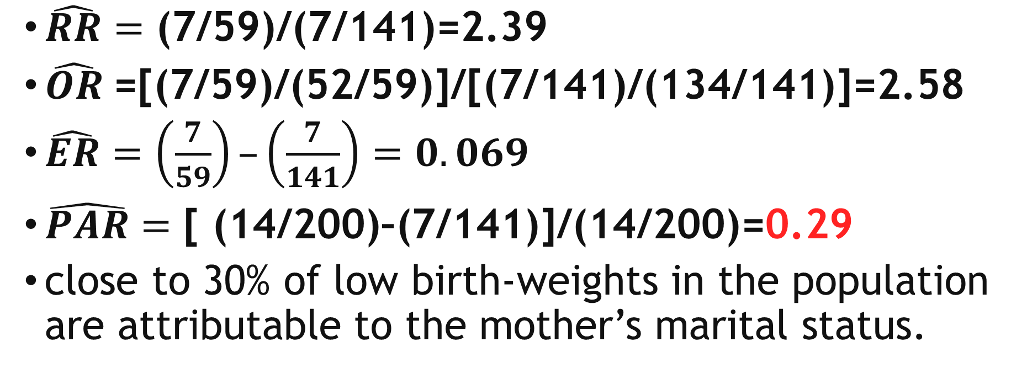
Effect Measures
$\hat{RR}=\text{(}\text{7}\text{/}\text{59}\text{)/(}\text{7}\text{/}\text{141}\text{)=}\text{2.39}$
$\hat{OR}$=[(7/59)/(52/59)]/[(7/141)/(134/141)]=2.58
$\hat{ER}=\left(\frac{7}{59}\right)–\left(\frac{7}{141}\right)=0.069$
$\hat{PAR}=\text{[ (}\text{14}\text{/}\text{200}\text{)–(}\text{7}\text{/}\text{141}\text{)]/(}\text{14}\text{/}\text{200}\text{)=}\text{0.29}$
close to 30% of low birth-weights in the population are attributable to the mother’s marital status.

Slide 15
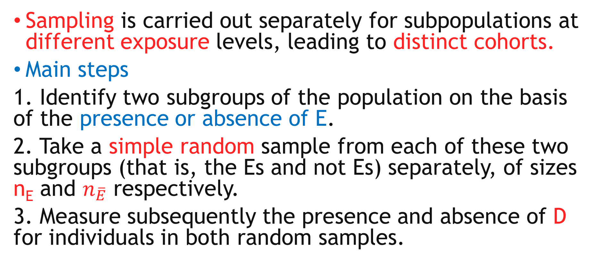
5.2 Exposure-based sampling—cohort studies
Sampling is carried out separately for subpopulations at different exposure levels, leading to distinct cohorts.
Main steps
1. Identify two subgroups of the population on the basis of the presence or absence of E.
2. Take a simple random sample from each of these two subgroups (that is, the Es and not Es) separately, of sizes n_{E} and $n_{\overline{E}}$ respectively.
3. Measure subsequently the presence and absence of D for individuals in both random samples.

Slide 16
Selecting of two random samples, size 100, from the population of unmarried and married mothers.
This design assumes that, prior to sampling, one is able to divide the population by marital status into two distinct sampling frames.

Slide 17
Calculation
Joint probabilities cannot be estimated.
Marginal probabilities are not estimable.
Only conditional probabilities that condition on exposure status can be estimated.
𝑷(𝑫│𝑬)= 12/100=0.12
𝑷(𝑫|𝑬 ̅)= 5/100=0.05
Notes:
زیرا شروع مطالعه از گروه مواجهه یافته و مواجهه نیافته است و این بستگی به این دارد که چه نسبتی از این گروه ها برای ورود به مطالعه انتخاب شوند.

Slide 18
Effect measures
خطر منتسب جمعیت به دلیل اینکه احتمال مواجهه را در جمعیت نمی‌دانیم در این روش نمونه گیری قابل محاسبه نیست (نیاز به بحث دارد- در کوهورت کلاسیک).

Slide 19
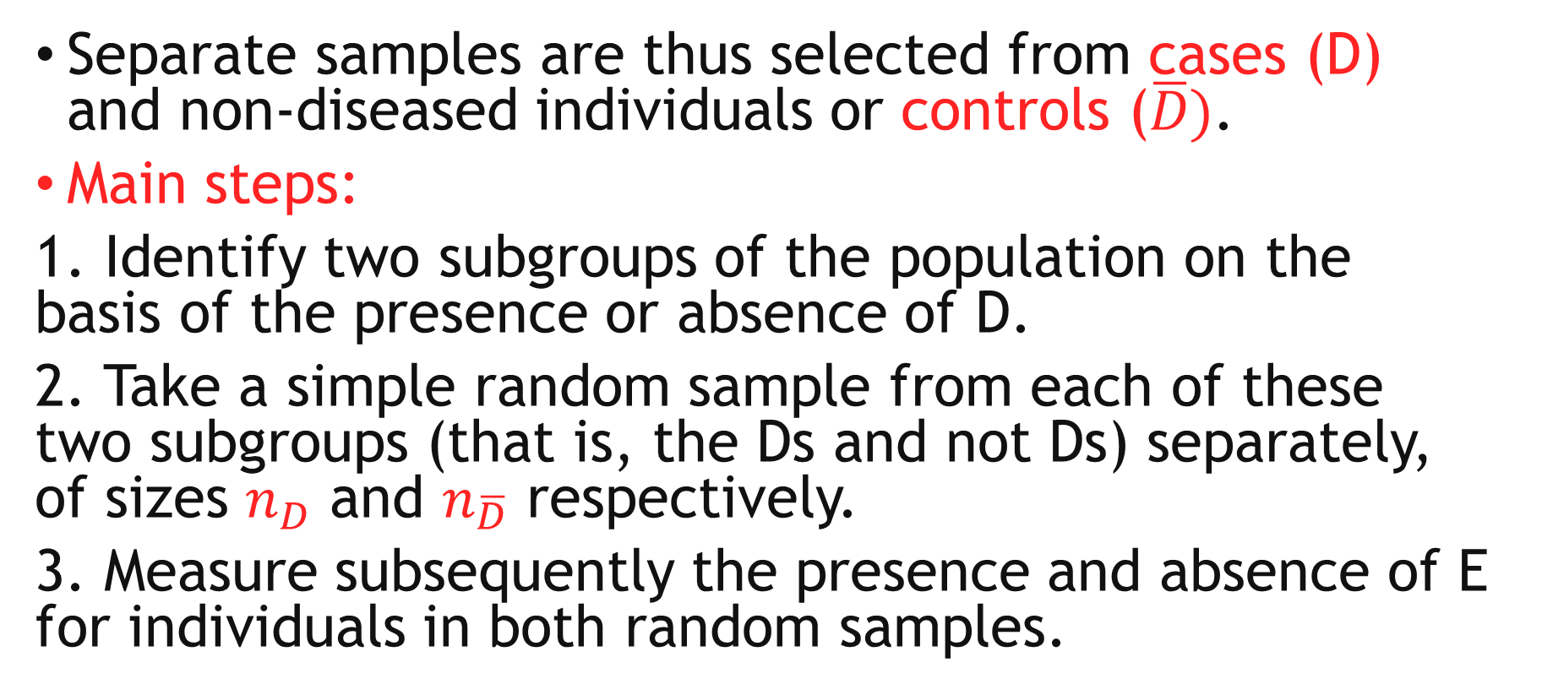
5.3 Disease-based sampling—case-control studies
Separate samples are thus selected from cases (D) and non-diseased individuals or controls ($\overline{D})$.
Main steps:
1. Identify two subgroups of the population on the basis of the presence or absence of D.
2. Take a simple random sample from each of these two subgroups (that is, the Ds and not Ds) separately, of sizes $n_{D}$ and $n_{\overline{D}}$ respectively.
3. Measure subsequently the presence and absence of E for individuals in both random samples.

Slide 20
1- assumes two sampling frames.
2- Investigator must pre-specify the number of cases and controls

Slide 21
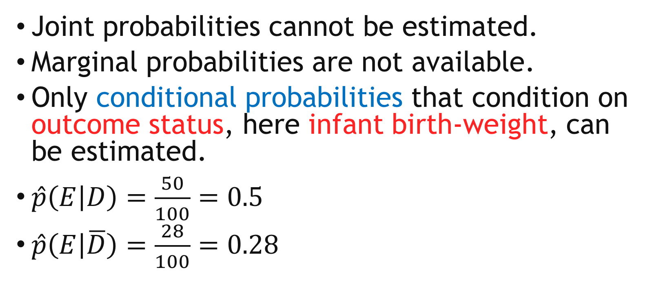
calculation
Joint probabilities cannot be estimated.
Marginal probabilities are not available.
Only conditional probabilities that condition on outcome status, here infant birth-weight, can be estimated.
$\hat{p}\left(E | D\right)=\frac{50}{100}=0.5$
$\hat{p}\left(E | \overline{D}\right)=\frac{28}{100}=0.28$

Slide 22
Effect measures
This is indeed partly true in that it is impossible to estimate the Relative Risk or the Excess Risk with case-control data.
Odds Ratio= [P(E|D)]/[P(notE|D)]/[P(E|not D)]/[P(not E|not D)].
Identical to: Odds Ratio for D associated with E.
OR= (0.5/0.5)/ (0.28/0.72)= 2.57

Slide 23
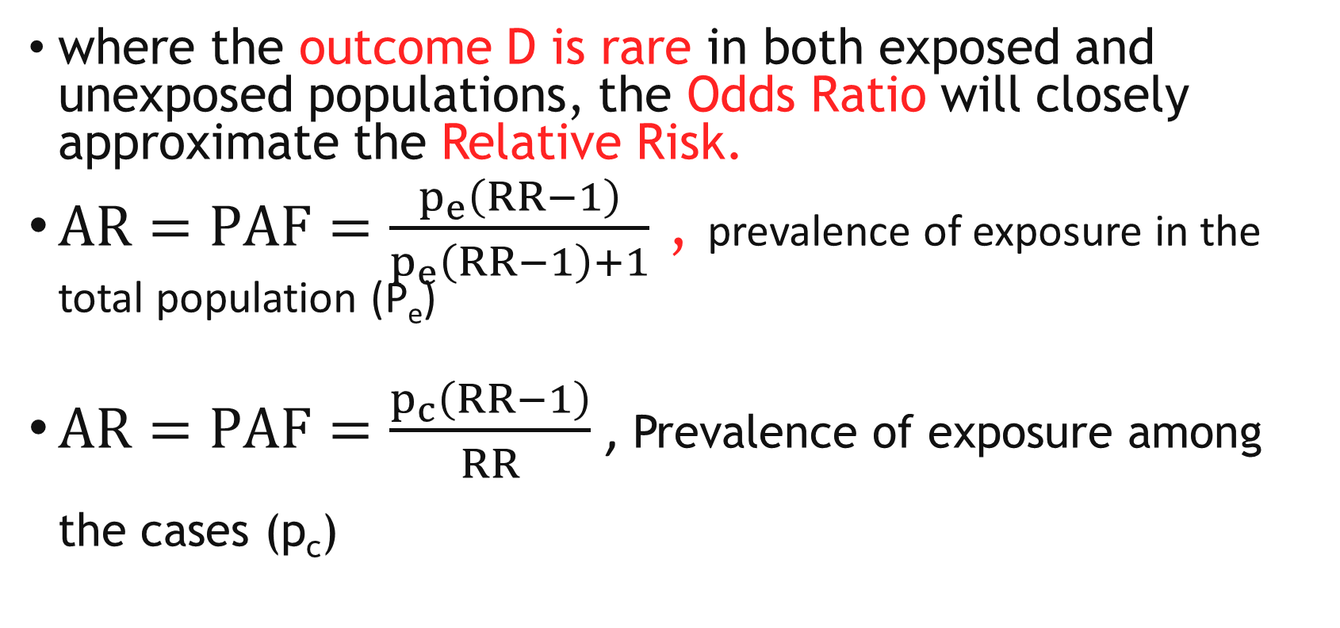
where the outcome D is rare in both exposed and unexposed populations, the Odds Ratio will closely approximate the Relative Risk.
$AR=PAF=\frac{p_{e}\left(RR−1\right)}{p_{e}\left(RR−1\right)+1}$ , prevalence of exposure in the total population (P_{e})
$AR=PAF=\frac{p_{c}\left(RR−1\right)}{RR}$ , Prevalence of exposure among the cases (p_{c})

Slide 24
Notes:
در کسر بالا صورت و محرج به نسبت خطر ضرب شدند

Slide 25
Analysis of case-control study
Before 1951: Exposure proportion difference in Cases and Controls
Cornfield(1951): odds ratio an estimate of relative risk with rare disease assumption
Miettinen (1976): no need for rare disease assumption: incidence cases and controls were recruited concurrently.

Slide 26
Traditional Design
Traditionally controls were sampled from the population still at risk at the end of the study period.
In this case the odds of exposure among controls will provide an estimate of (N₁-D₁) / (N₀-D₀).
So with this sampling scheme a case control study will provide an estimate of the Odds Ratio.

Slide 27
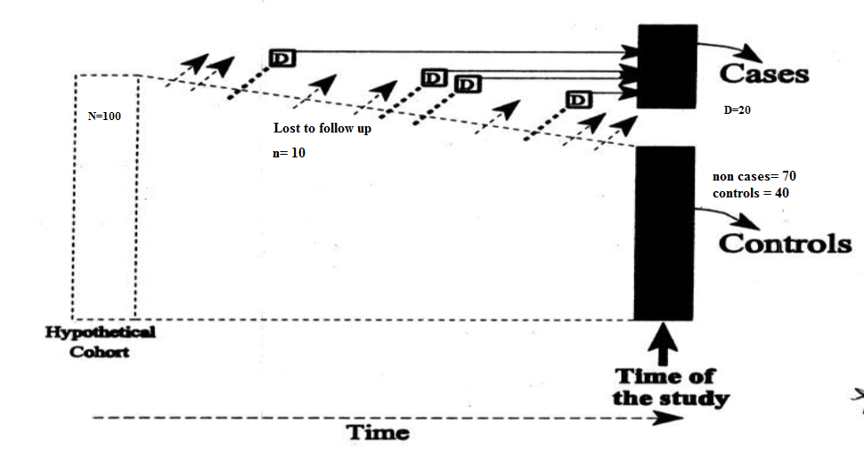
Case-control study: cumulative sampling of controls

Slide 29
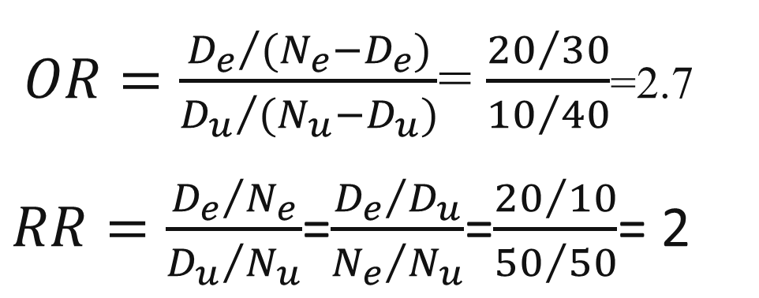
Example
× | × | × | × | ×
× | × | × | × | ×
× | × | × | × | × | × | × | × | × | ×
× | × | × | × | × | × | × | × | × | ×
$OR=\frac{{D_{e}}/{{(N}_{e}}−D_{e})}{{D_{u}}/{{(N}_{u}}−D_{u})}$= $\frac{{20}/{30}}{{10}/{40}}$=2.7
$RR=\frac{{D_{e}}/{N_{e}}}{{D_{u}}/{N_{u}}}$=$\frac{{D_{e}}/{D_{u}}}{{N_{e}}/{N_{u}}}$=$\frac{{20}/{10}}{{50}/{50}}$= 2

Slide 30
5.4 Key variants of the case-control design
The rare disease assumption appears to preclude situations where either the disease frequency is high or, essentially equivalently, the interval of risk underlying the definition of disease incidence is sufficiently long so that the cumulative incidence over the entire interval is high.
Notes:
در موارد بالا بودن فراوانی بیماری یا طولانی بودن طول دوره در معرض خطر بودن، فرض نادر بودن بیماری دچار اشکال می شود.

Slide 31
solutions
divide the risk interval into smaller subintervals, then to carry out separate case-control studies for each subinterval of risk.
In practice, it is natural to implement case-control designs in this fashion when cases can only be sampled as they accumulate in a population.
These modified designs are called nested case-control studies
Notes:
بدنبال تجمع تعدادی مورد در جمعیت می توان این برش ها را در زمان انجام داد

Slide 32
در موارد بیماری شایع، برآورد اثر به نحوه انتخاب شاهدها در مطالعه مورد-شاهدی بستگی دارد (یعنی نسبت شانس به نسبت انتخاب کنترل ها بستگی دارد زیرا بیماران در هر سه نوع مطالعه یکسان هستند).
اگر نسبت شاهدهای مواجهه یافته به مواجهه نیافته، نسبت مواجهه و مواجهه نیافته در کوهورت فرضی را برآورد کند، نسبت شانس خطر نسبی را برآورد می کند.
اگر نسبت شاهدهای مواجهه یافته و مواجهه نیافته، برآوردی از نسبت شخص-زمان در معرض خطر در دو گروه باشد، آنگاه نسبت شانس، نسبت ریت یا نسبت هازارد را برآورد می کند.

Slide 33
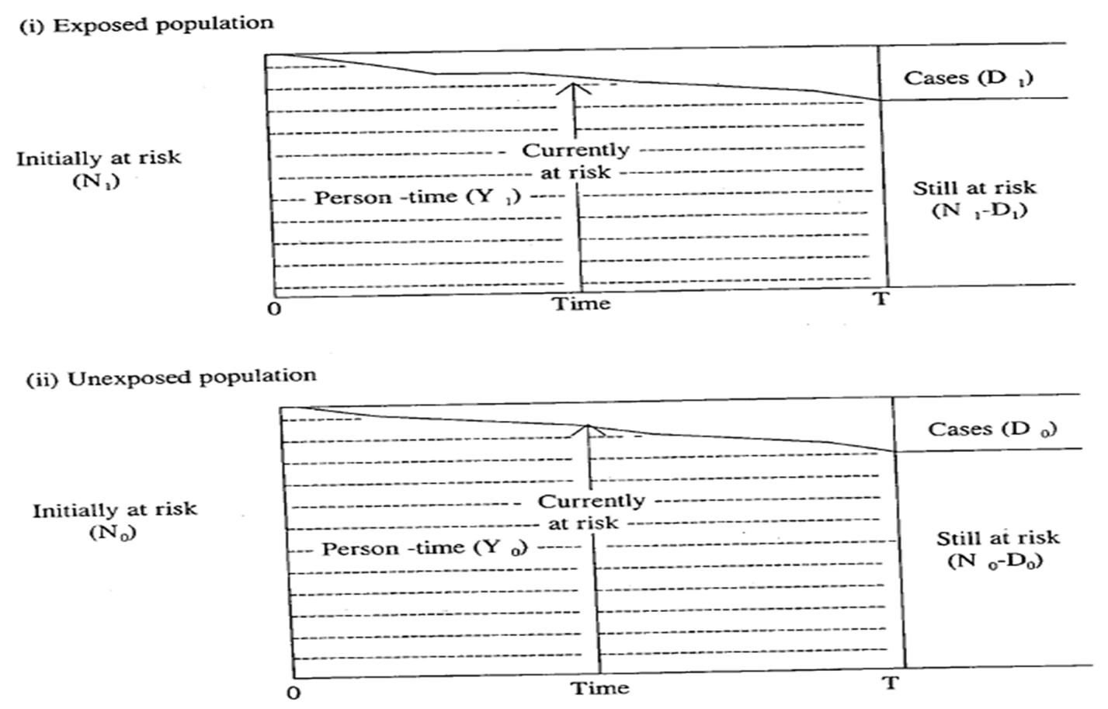

Slide 34
5.4.1 Risk-set sampling of controls (density sampling)
For each incident case that is identified and sampled at time t, one or more controls are randomly drawn from the population of individuals still at risk of disease at t.
Exposure measurements are taken for each case and for its corresponding set of sampled controls.
This is a stratified, or matched, case-control design where the strata are defined by the times at risk over the interval [0, T].

Slide 36
it is possible for a control sampled at time t to later become a case and enter the sample a second time.
this is unlikely in large populations unless the disease is common.
It accommodates the possibility that the study population is dynamic in that individuals may enter and leave the population.

Slide 37
prior infection with HSV-2 and cervical cancer
possibility that an individual’s exposure level changes over time: If exposure assessment applies at the time of sampling for both cases and controls.
Example: study population consisted of 550,000 women (Finland, Norway, and Sweden). For each Cases of cervical cancer, three controls were also chosen from the serum bank who were cancer-free at the time of diagnosis of the case.

Slide 38
Notes:
نسبت افراد مواجهه یافته از کل جمعیت در هر لحظه از زمان. و ام هم تعداد افراد کنترل انتخاب شده .
اگر فرض پروپورشنالیتی برقرار باشد بنابراین هازارد ریشیو به زمان وابسته نیست (ثابت در طول زمان) بنابراین می توان نتیجه گرفت نسبت شانس هم ثابت است در زمان.

Slide 39
5.4.2 Case-cohort studies
m controls are chosen at random from the entire population at risk at t=0 (of size N, say), the beginning of the risk period.
Here, the controls may, in fact, include a case and vice versa.

