Slide 1
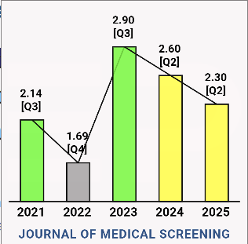
Evaluating the diagnostic accuracy of fecal immunochemical testing in the two-week wait referral pathway for colorectal cancer in the UK
Sarala Janarthanan
First published online June 16, 2025, volume 0, Issu 0
Journal of Medical Screening, Impact Factor: 2.3

Slide 2
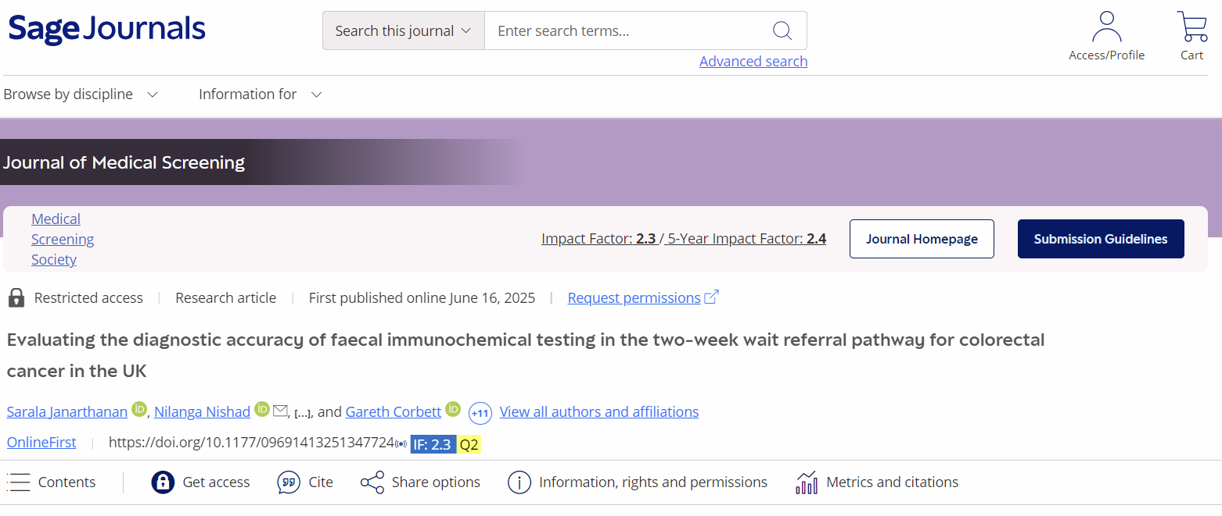

Slide 3
Table of content
Introduction
Method
Sensitivity & specificity
False positive paradox
PPV & NPV
LR+ & LR-
Confidence intervals
Accuracy
ROC curve
Youden index
DOR
Result
Discussion & Conclusion

Slide 4
introduction
CRC is a significant public health concern and second leading cause of cancer-related deaths
Effective strategies can lead to early detection, that could be potentially life-saving with timely treatment, thereby reducing the overall burden and death of this disease
Screening program in Uk is FIT test
This study aimed to evaluate the diagnostic accuracy of FIT in detecting CRC and advanced adenomas and to determine the sensitivity, specificity, positive predictive value (PPV), and NPV of the FIT test in a real-world clinical setting

Slide 5
method
NG12, NICE criteria(1)
high risk
aged 40 and over with unexplained weight loss and abdominal pain
aged 50 and over with unexplained rectal bleeding
aged 60 and over with iron-deficiency anaemia or changes in their bowel habit
occult blood in their faeces shown by tests
included patients referred between January 2023 and August 2023

Slide 6
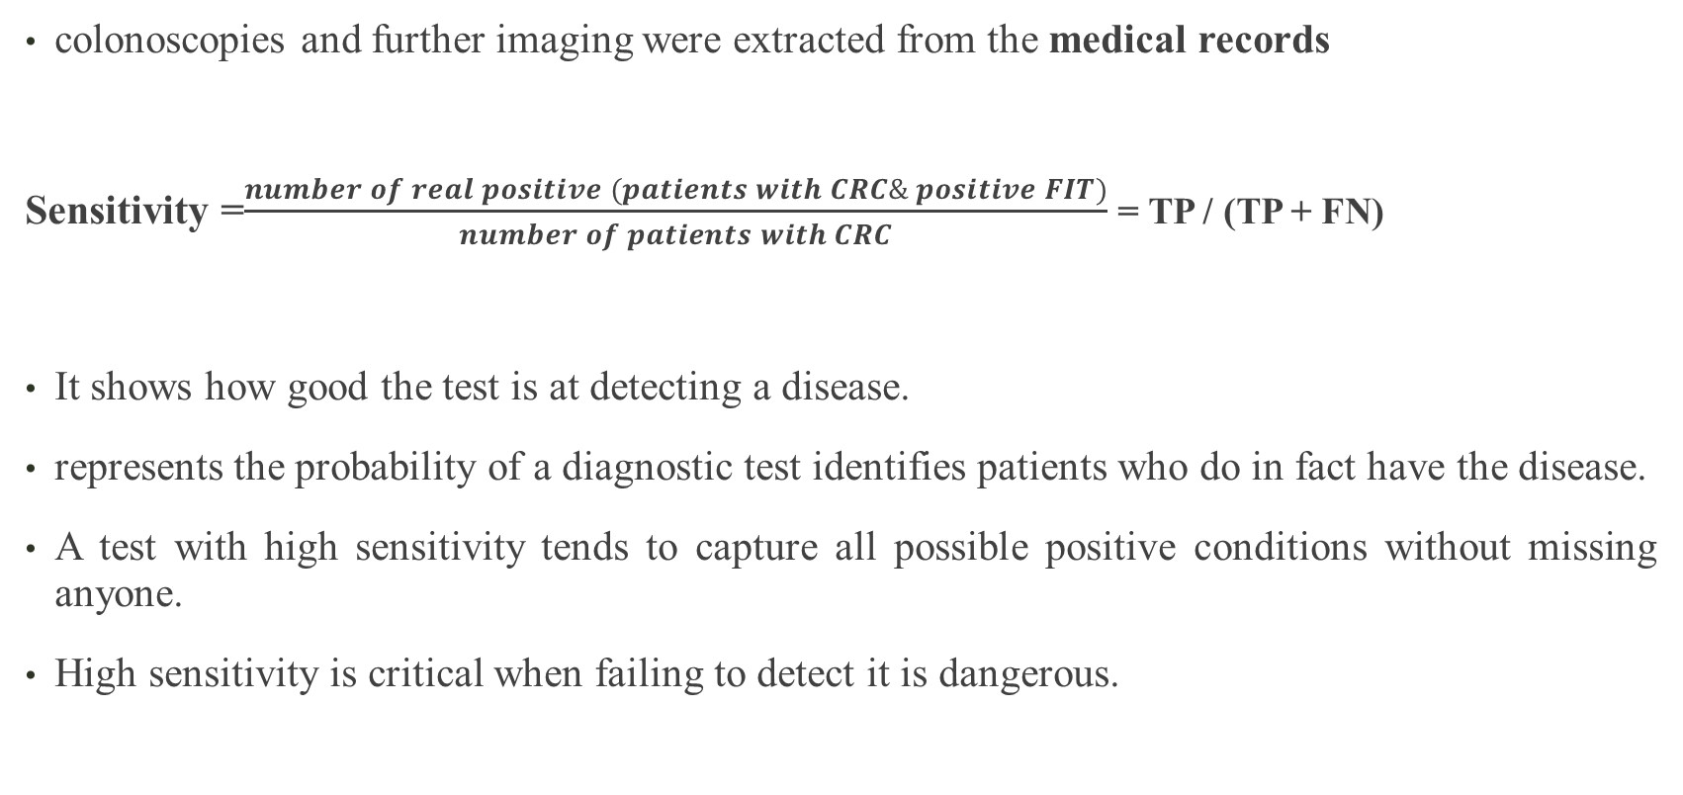
Method (Sensitivity)
colonoscopies and further imaging were extracted from the medical records
Sensitivity =$\frac{number of real positive (patients with CRC\& positive FIT)}{number of patients with CRC}$ = TP / (TP + FN)
It shows how good the test is at detecting a disease.
represents the probability of a diagnostic test identifies patients who do in fact have the disease.
A test with high sensitivity tends to capture all possible positive conditions without missing anyone.
High sensitivity is critical when failing to detect it is dangerous.

Slide 7
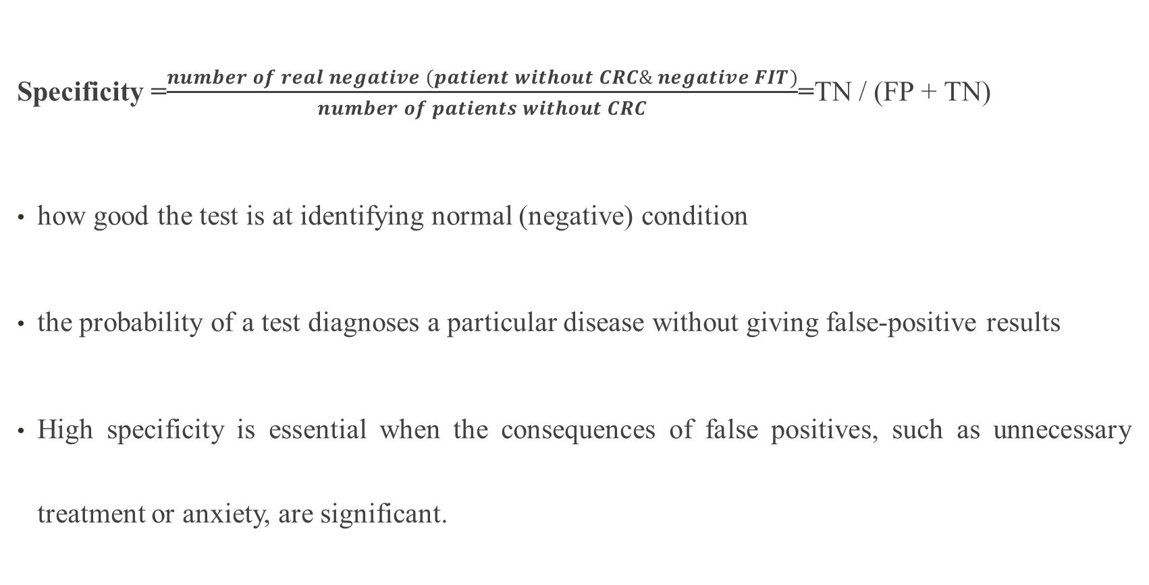
Method (Specificity)
Specificity =$\frac{number of real negative (patient without CRC\& negative FIT)}{number of patients without CRC}$=TN / (FP + TN)
how good the test is at identifying normal (negative) condition
the probability of a test diagnoses a particular disease without giving false-positive results
High specificity is essential when the consequences of false positives, such as unnecessary treatment or anxiety, are significant.

Slide 8
Method (Sensitivity vs Specificity)
Sensitivity vs Specificity Benchmark Values
A test can be very specific without being sensitive, or it can be very sensitive without being specific so it can vary depending on the field.
For example, a screening test for a severe disease might prioritize high sensitivity to minimize missed cases
a test with high specificity can still return many false positives when practitioners use it widely in a population with low prevalence. This phenomenon is the false positive paradox.

Slide 9
false positive paradox?
Sensitivity 97%
Specificity 98%
Prevalece 1%
9702
population
healthy
negative
positive
diseased
positive
negative
98%
9900
99%
10000
2%
100
1
=
198
300
3
97
97%
1%
100
3%
3
(2)

Slide 10
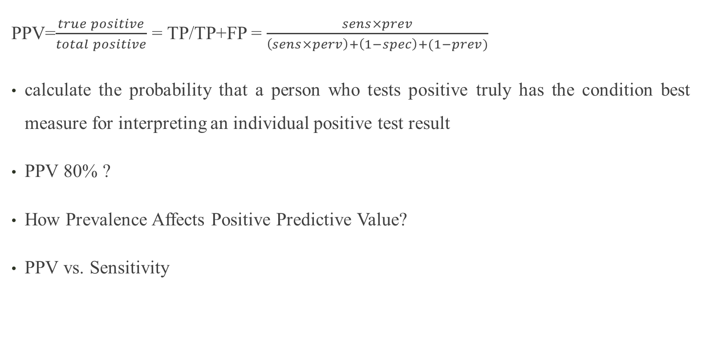
Positive predictive value
PPV=$\frac{true positive}{total positive}$ = TP/TP+FP = $\frac{sens×prev}{\left(sens×perv\right)+\left(1−spec\right)+(1−prev)}$
calculate the probability that a person who tests positive truly has the condition best measure for interpreting an individual positive test result
PPV 80% ?
How Prevalence Affects Positive Predictive Value?
PPV vs. Sensitivity

Slide 11
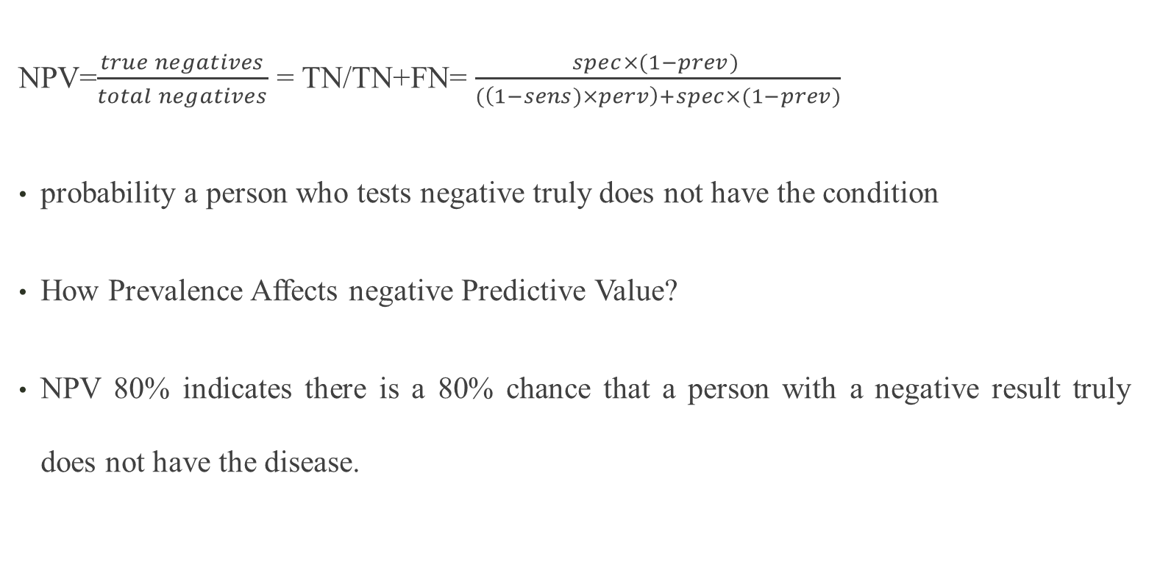
Negative predictive value
NPV=$\frac{true negatives}{total negatives}$ = TN/TN+FN= $\frac{spec×(1−prev) }{(\left(1−sens)×perv\right)+spec×(1−prev)}$
probability a person who tests negative truly does not have the condition
How Prevalence Affects negative Predictive Value?
NPV 80% indicates there is a 80% chance that a person with a negative result truly does not have the disease.

Slide 12
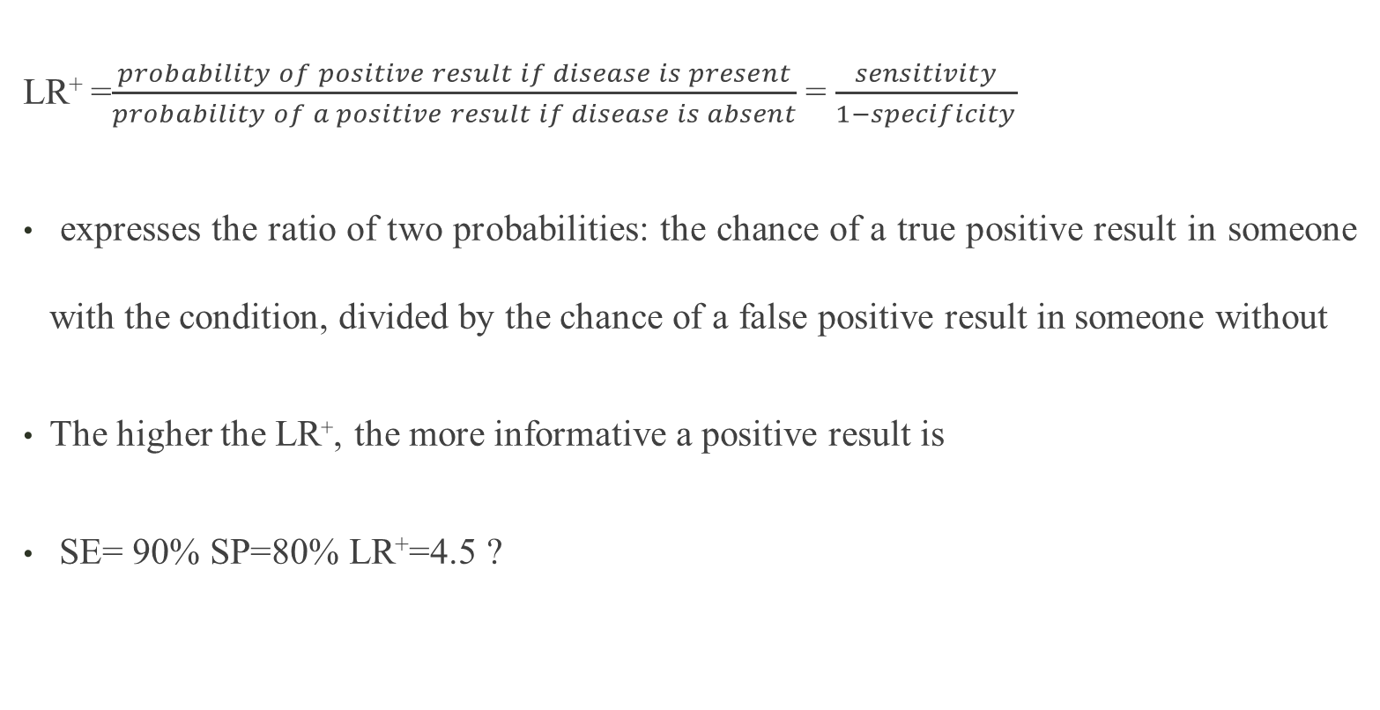
Positive Likelihood Ratio
LR⁺ =$\frac{probability of positive result if disease is present}{probability of a positive result if disease is absent}$ = $\frac{sensitivity}{1−specificity}$
expresses the ratio of two probabilities: the chance of a true positive result in someone with the condition, divided by the chance of a false positive result in someone without
The higher the LR⁺, the more informative a positive result is
SE= 90% SP=80% LR⁺=4.5 ?

Slide 13
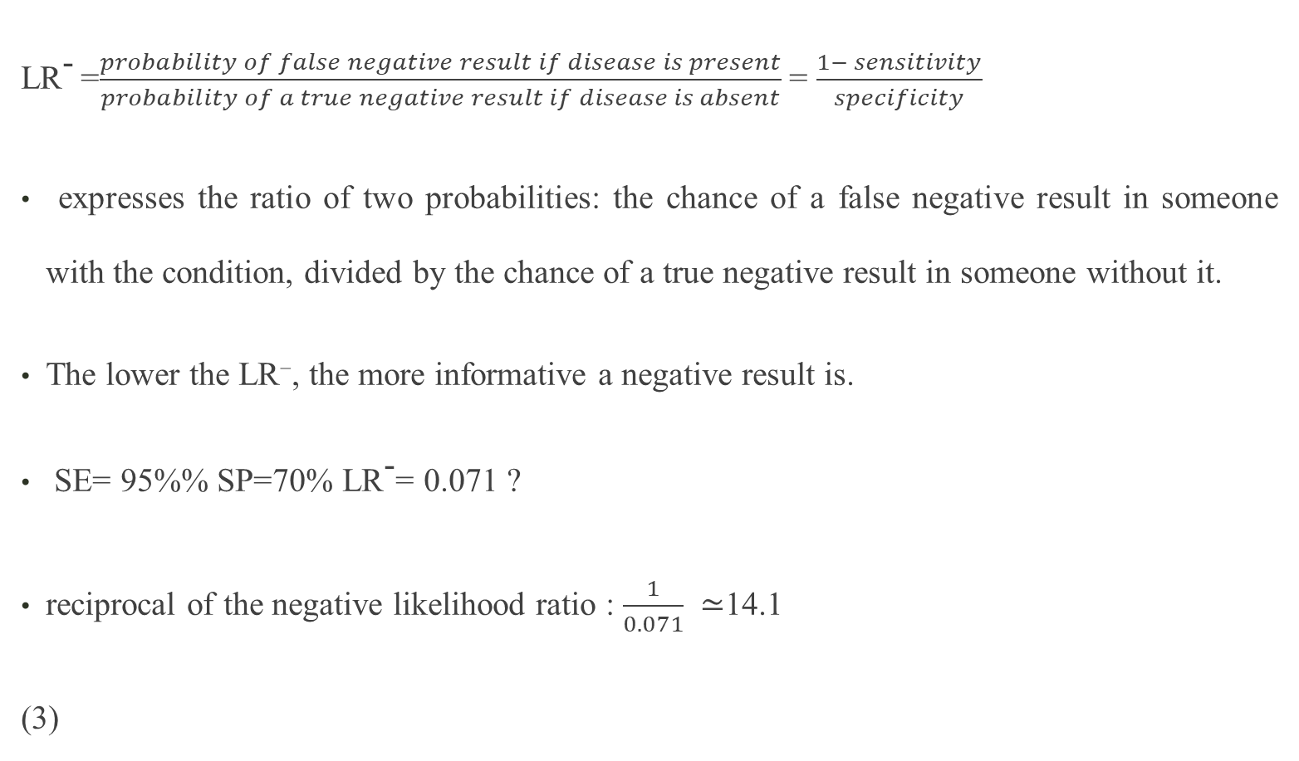
Negative Likelihood Ratio
LR⁻ =$\frac{probability of false negative result if disease is present}{probability of a true negative result if disease is absent}$ = $\frac{1− sensitivity}{specificity}$
expresses the ratio of two probabilities: the chance of a false negative result in someone with the condition, divided by the chance of a true negative result in someone without it.
The lower the LR⁻, the more informative a negative result is.
SE= 95%% SP=70% LR⁻= 0.071 ?
reciprocal of the negative likelihood ratio : $\frac{1}{0.071} ≃$14.1
(3)

Slide 14
Confidence intervals (SE, SP, NPV& PPV)
Two types of 95% CI are generally constructed around proportions: asymptotic and exact 95% confidence interval
The exact confidence interval is constructed by using binomial distribution to reach an exact estimate.
Asymptotic confidence interval is calculated by assuming a normal approximation of the sampling distribution.

Slide 15

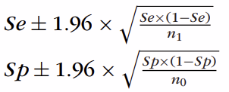
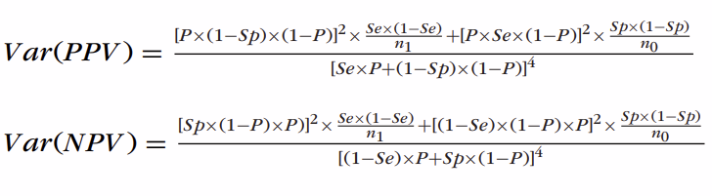

Confidence intervals (SE, SP, NPV & PPV)
Normal distribution:
disease+
Disease_
Test+
n₁₁
n₀₁
Test-
n₁₀
n₀₀
n₁
n₀

Slide 16
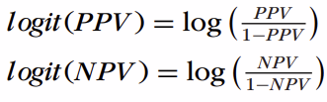
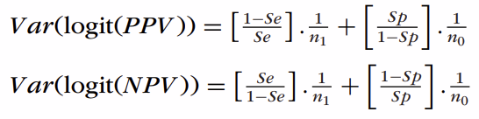
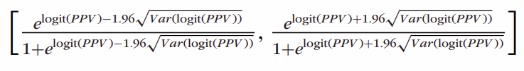

Confidence intervals (SE, SP, NPV & PPV)
When the PPV or NPV is close to 0 or 1, their 95% CIs calculated using the normal approximation can be out of the desired range of 0 to 1. The logit transformation, as described below, can be used to calculate the 95% CIs to guarantee that they fall between 0 and 1.
(4,5,6)

Slide 17
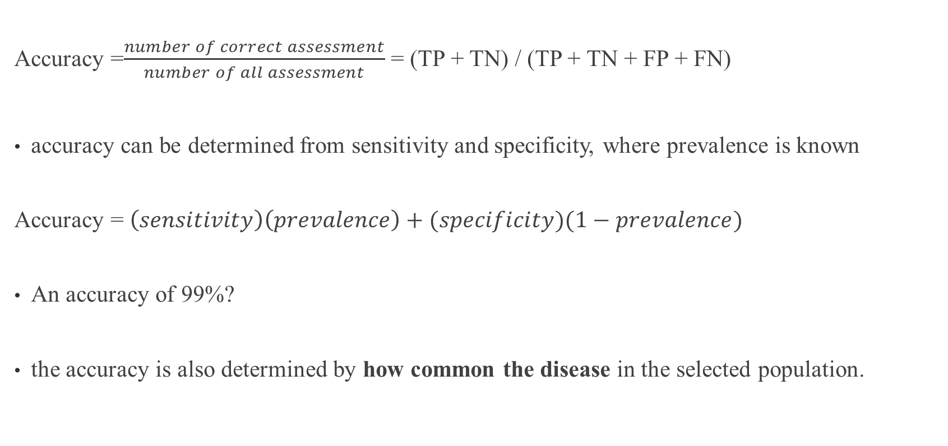
Method (Accuracy)
Accuracy =$\frac{number of correct assessment}{number of all assessment}$ = (TP + TN) / (TP + TN + FP + FN)
accuracy can be determined from sensitivity and specificity, where prevalence is known
Accuracy = $\left(sensitivity\right)\left(prevalence\right)+(specificity)(1−prevalence)$
An accuracy of 99%?
the accuracy is also determined by how common the disease in the selected population.

Slide 18
ROC curve
It shows the tradeoff between sensitivity and specificity (any increase in sensitivity will be accompanied by a decrease in specificity).
TPR= TP/(TP+FN)= sensitivity
FPR = FP/(FP+TN)= 1- specificity
The closer the curve follows the left-hand border, the more accurate the test.
The closer the curve comes to the 45-degree diagonal of the ROC space, the less accurate the test.
The slope of the tangent line at a cut point gives the likelihood ratio (LR) for that value of the test.
Receiver Operating Characteristic curve

Slide 19
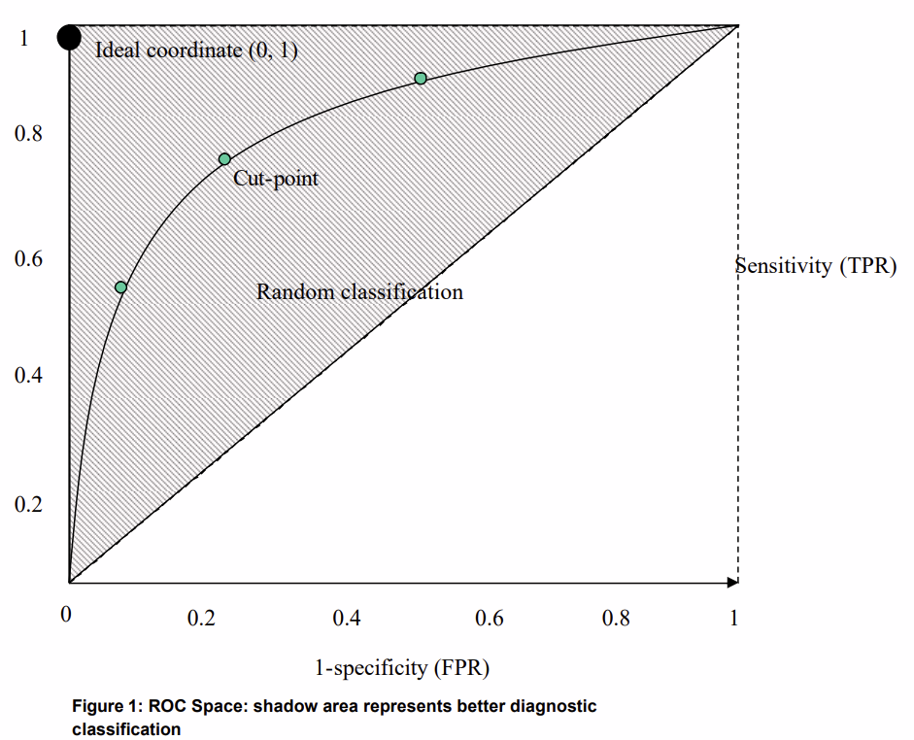
ROC curve
Accuracy is measured by the area under the ROC curve
90-1 = excellent
.80-.90 = good
.70-.80 = fair
.60-.70 = poor
.50-.60 = fail
(4)
Receiver Operating Characteristic curve

Slide 20

Youden index
used to evaluate the effectiveness of a diagnostic test
is defined as the maximum vertical distance between the ROC curve and the diagonal line of no discrimination
determine the optimal cut-off point for a test
does not account for the prevalence, so even a test with a high Youden Index may not be clinically useful if the disease is rare.

Slide 21
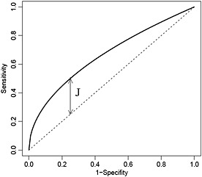
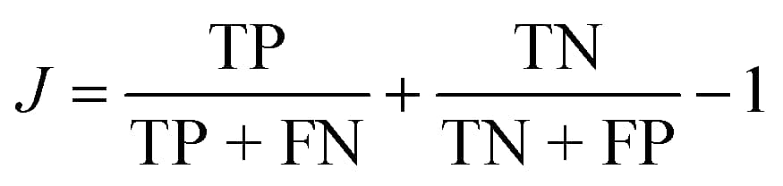
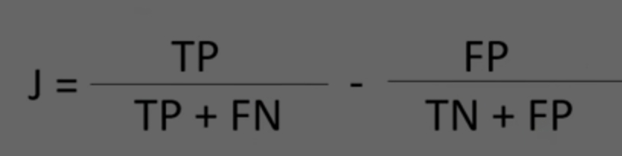
Youden index
Youden Index vs AUC
Youden Index focuses on sensitivity and specificity, AUC provides a
broader view of a test’s performance across all possible cut-off points
Interpreting the Youden Index Value
ranges from -1 to 1
1 indicates perfect sensitivity and specificity
a value of 0 indicates no diagnostic ability(7)
TPR
FPR

Slide 22
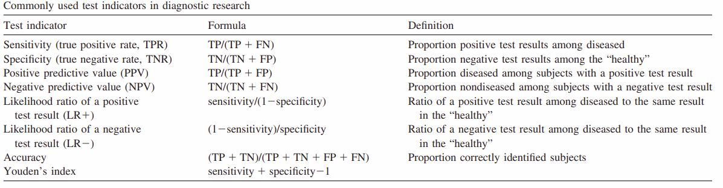
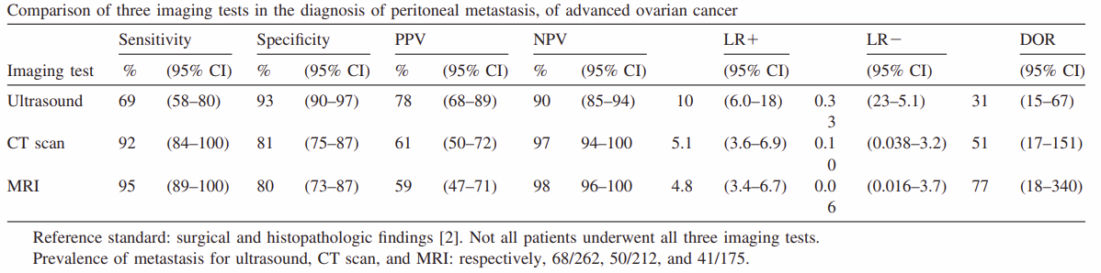
Diagnostic odds ratio (DOR)
none of these indicators in itself validly represent the test’s discriminatory performance
the comparison of diagnostic accuracies between two or more diagnostic tests

Slide 23



Diagnostic odds ratio (DOR)
Youden’s index but because it is a linear transformation of the mean sensitivity and specificity, its values are difficult to interpret
DOR is The diagnostic odds ratio of a test is the ratio of the odds of positivity in disease relative to the odds of positivity in the non-diseased
value of a DOR ranges from 0 to infinity

Slide 24
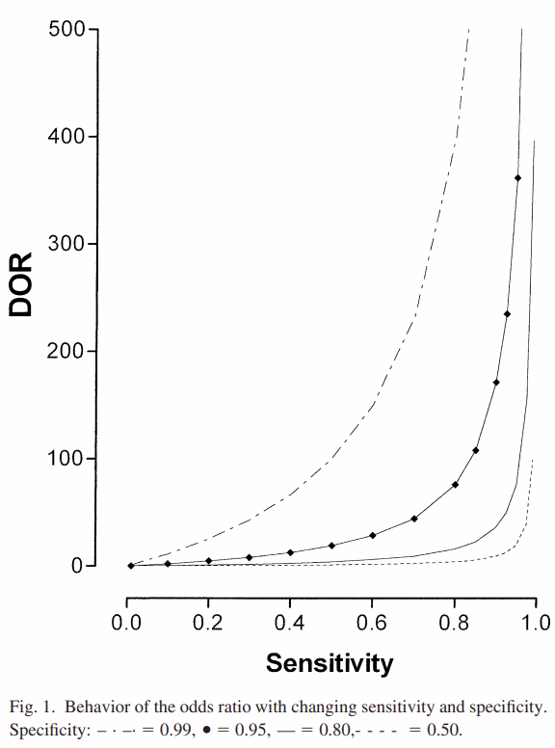
Diagnostic odds ratio (DOR)
value of a DOR ranges from 0 to infinity
A test with high specificity and sensitivity with low rate of false positives and false negatives has high DOR
With the same sensitivity of the test, DOR increases with the increase of the test specificity
not depend on the prevalence of the disease but depend on the spectrum
of disease severity (8)

Slide 25
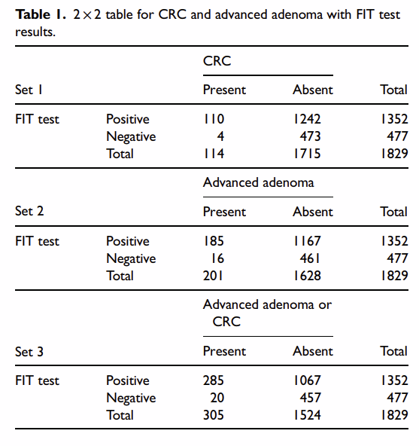
result

Slide 26
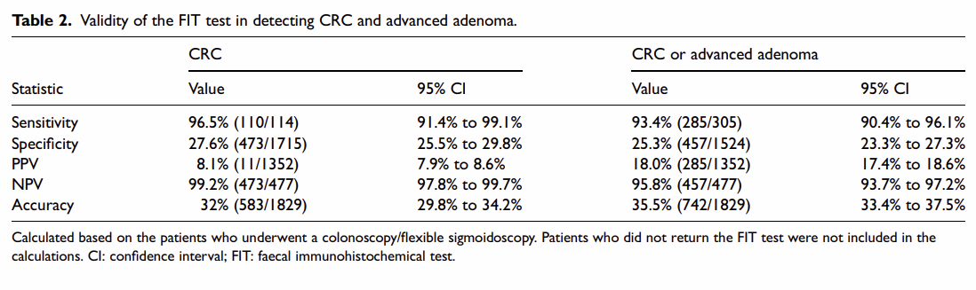
result

Slide 27
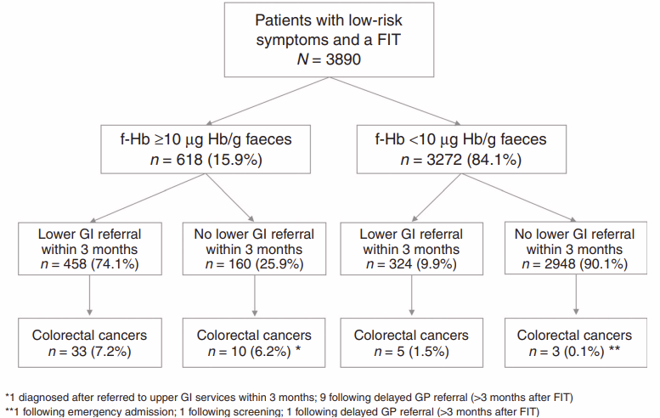
Diagnostic performance of a faecal immunochemical test for patients with low-risk symptoms of colorectal cancer in primary care: an evaluation in the South West of England(9)
British Journal of Cancer (2021) 124:1231–1236; https://doi.org/10.1038/s41416-020-01221-9
Fig.1 Flow diagram of referrals and diagnoses in patients with a FIT

Slide 28
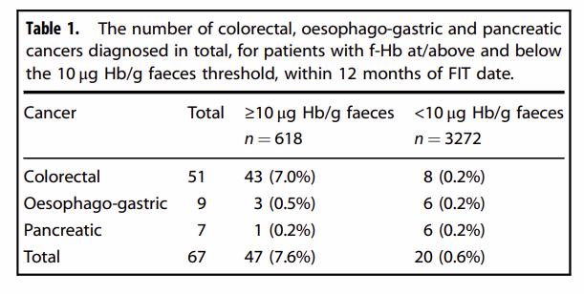





result
cancer
+
_
$$\frac{43}{51}$$
$$\frac{3264}{3272}$$
SE=
=0.843
NPV=
=0.998
+
$$\begin{matrix}43 & 575 & 618 \\ 8 & 3264 & 3272 \\ 51 & 3839 & 3890\end{matrix}$$
FIT
_
SP=
$$\frac{3264}{3839}$$
=0.850
PPV=
$$\frac{43}{618}$$
=0.070
Total

Slide 29
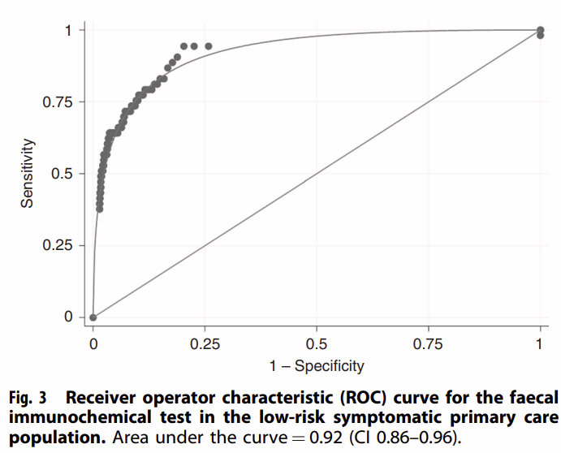
ROC curve
The sensitivity in this population is 84.3% (CI 71.4–93.0%), and the specificity 85.0% (83.8–86.1%).The area under the ROC curve is 0.92 (CI 0.86–0.96)
Receiver Operating Characteristic curve

Slide 30
Discussion & Conclusion
The high NPV (99.2%) high sensitivity (96.5%) is reassuring, but low specificity and PPV indicate that a significant number of patients with positive FIT results may not have CRC
FIT should be used in conjunction with other diagnostic methods:
Risk stratification models
machine learning development
Limitations:
not detailed the characteristics of advanced adenomas
causality

Slide 31
References
1. E1. Excellence NIfHaC. Quantitative faecal immunochemical testing to guide colorectal cancer pathway referral in primary care London: NICE24 August 2023 [Available from: https://www.nice.org.uk/guidance/dg56.
2. London ksC. "There's a math for that" - the paradox of the false posistive. 25/11/2013.
3. Frost J. sensitivity vs Specificity: Definition, Formulas & Interpreting 2025 [Available from: https://statisticsbyjim.com/basics/sensitivity-vs-specificity/.
4. Zhu W, Zeng N, Wang N. Sensitivity, Specificity, Accuracy, Associated Confidence Interval and ROC Analysis with Practical SAS ® Implementations. NorthEast SAS users group, health care and life sciences. 2010
5. Ying GS, Maguire MG, Glynn RJ, Rosner B. Calculating Sensitivity, Specificity, and Predictive Values for Correlated Eye Data. Invest Ophthalmol Vis Sci. 2020;61(11):29.
6. Mercaldo ND, Lau KF, Zhou XH. Confidence intervals for predictive values with an emphasis to case-control studies. Stat Med. 2007;26(10):2170-83.
7. EASILY LS. What is: Youden Index? 2025 [Available from: https://statisticseasily.com/glossario/what-is-youden-index-understanding-its-importance/.
8. Glas AS, Lijmer JG, Prins MH, Bonsel GJ, Bossuyt PM. The diagnostic odds ratio: a single indicator of test performance. J Clin Epidemiol. 2003;56(11):1129-35.
9. Bailey SER, Abel GA, Atkins A, Byford R, Davies SJ, Mays J, et al. Diagnostic performance of a faecal immunochemical test for patients with low-risk symptoms of colorectal cancer in primary care: an evaluation in the South West of England. Br J Cancer. 2021;124(7):1231-6.

