Slide 1
The Factor Structure and Generalizability of the Iranian Socioeconomic Status (SES) Questionnaire
Supervisor: Dr. Ali Hosseinzadeh
Presenter: Zeynab Darini
Zeynabdarini99@gmail.com
Department of Epidemiology, Shahroud University of Medical Sciences
1/24

Slide 2
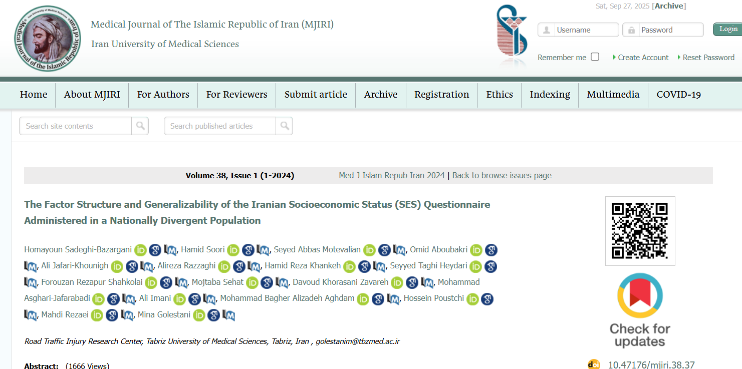
2/24

Slide 3
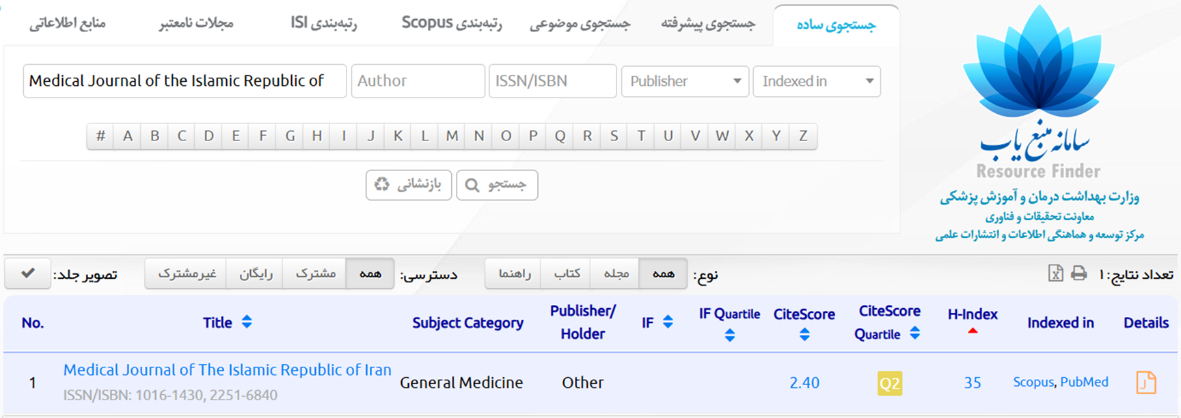
3/24

Slide 4
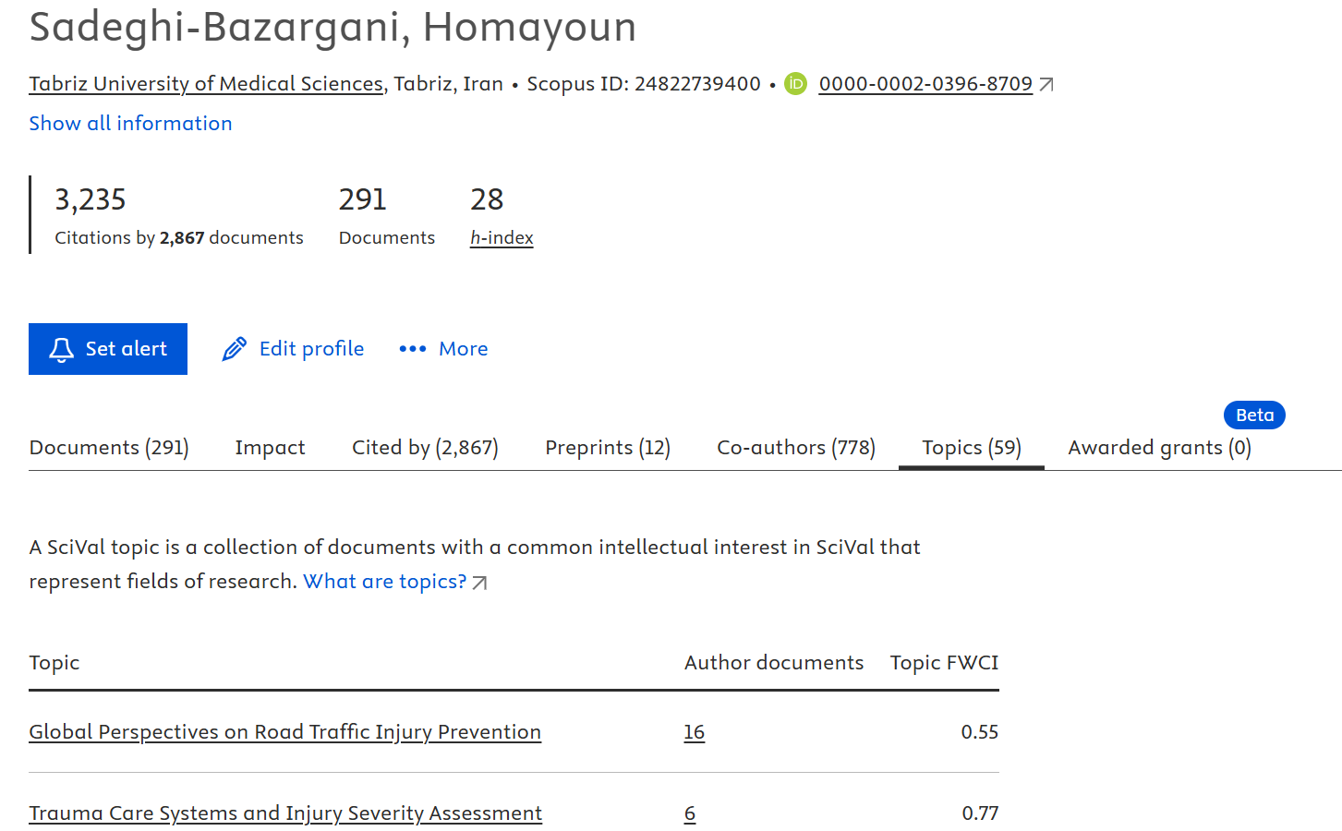
4/24

Slide 5
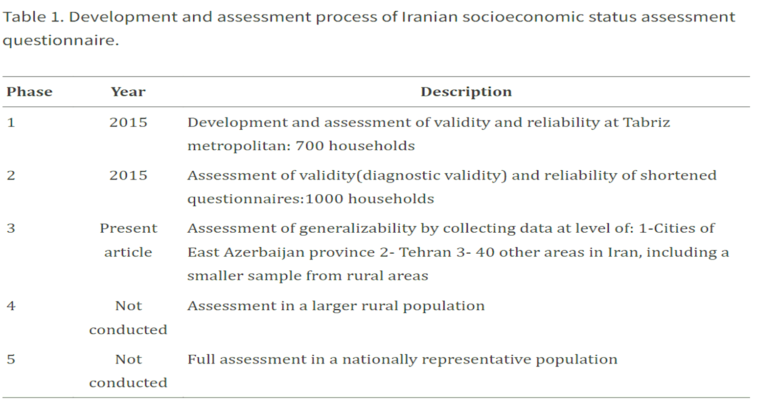
5/24

Slide 6
Psychometrics of the Questionnaire
Psychometrics of a questionnaire refers to the comprehensive evaluation of its measurement quality, focusing on:
Validity:
Validity refers to the degree to which an instrument accurately measures the construct it is supposed to measure.
Reliability:
Reliability refers to the consistency of the questionnaire’s results. A reliable questionnaire gives similar results under consistent conditions.
6/24

Slide 7
Validity
Content Validity:
Checks whether the items comprehensively cover all aspects of the construct.
Assessed by a panel of experts.
Construct validity:
Examines the questionnaire reflects the theoretical structure of the construct.
This is often tested using factor analysis (Exploratory or Confirmatory).
Criterion Validity:
Examines how well the questionnaire correlates with an external criterion.
7/24

Slide 8
Reliability
Internal consistency:
Assessed using Cronbach’s alpha, which measures how closely related the items are.
Test–Retest Reliability:
Administering the questionnaire to the same participants at two different times and examining the correlation between the scores (e.g., Intraclass Correlation Coefficient (ICC) or Pearson’s r).
Split-half reliability:
Divides items into two halves and examines the correlation between them.
Are both halves of the test consistent?
8/24

Slide 9
OUTLINE
Introduction
Methods: study design and population, the inclusion and exclusion criteria, construct validity, sample size, model evaluation indicators, internal consistency
Results: exploratory factor analysis, confirmatory factor analysis, internal consistency
Discussion: limitations
Conclusion
9/24

Slide 10
Introduction
Socioeconomic Status (SES) is defined as individuals or families position within a hierarchical social structure and is combined of variables, including job, education, income, wealth, and place of residence.
SES has a multidimensional structure requires a standardized measurement format for each society.
The study aimed to extensively evaluate the applicability and psychometric properties of the Iranian version of the SES questionnaire in a nationally divergent population in Iran.
10/24

Slide 11
Methods
Study design and population:
Study was conducted on a household level
3,000 households were selected via random cluster sampling and 250 students
From various areas of East Azerbaijan province and Tehran
Through interviews with trained interviewers
The inclusion and exclusion criteria:
(a) living with family members in the same residence
(b) similar goals and characteristics of all the household members
(c) shared family expenses
(d) consent to participate in the study
11/24

Slide 12
Methods…
Construct validity:
The factor loadings were measured using exploratory factor analysis (EFA) based on extracting the principal components and direct Oblimin rotation and confirmatory factor analysis (CFA) was used to determine the factors’ numbers.
Sample size: n=3240
10 participants were required to respond to each item
Model evaluation indicators:
The goodness of fit index (GFI), comparative fit index (CFI), incremental fit index (IFI), and root mean square error of approximation (RMSEA)
Internal consistency:
The Cronbach's alpha was calculated for the entire scale and the subscales.
12/24

Slide 13
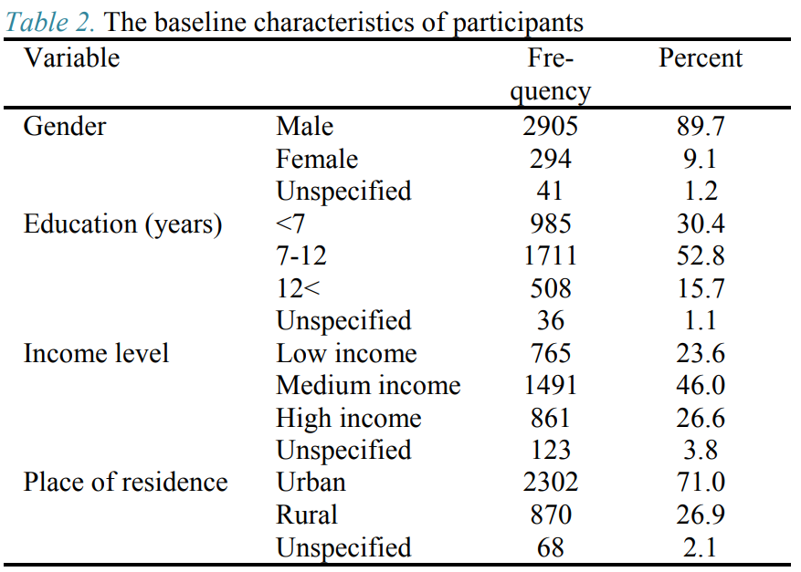
Results
13/24

Slide 14
Results…
Exploratory Factor Analysis:
Bartlett’s test were significant (P < 0.001)
The value of the Kaiser-Meyer-Olkin test was 0.912
The loadings of all the factors were considered appropriate
5 factors were extracted, included:
Occupation (5 items), self-evaluation of the economic capacity (6 items), wealth (5 items), house and furniture (4 items), and health expenditure (2 items)
The model could explain 64% of the variable variance.
14/24

Slide 15
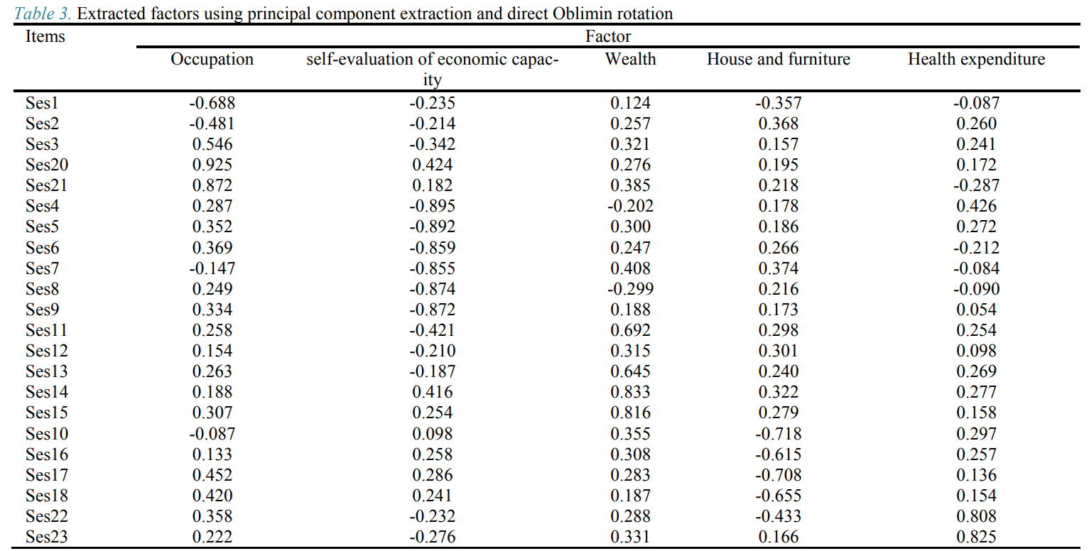
15/24

Slide 16
Results…
Confirmatory Factor Analysis:
The factors have moderate correlations, and the errors of some items were also correlated.
The standard coefficients indicated that all the coefficients were significant.
The confirmatory factor analysis results demonstrated the data's compatibility with the 5-factor model (CFI = 0.96, GFI = 0.95, IFI = 0.96, RMSEA = 0.05)
16/24

Slide 17
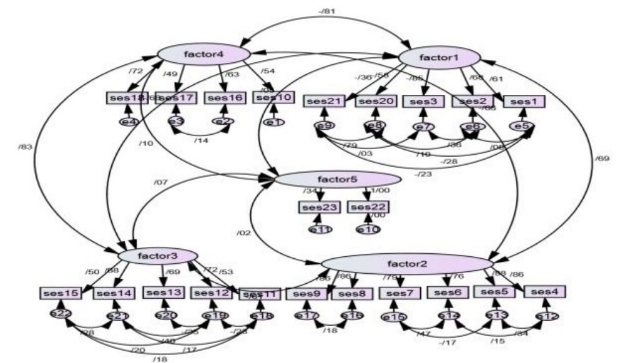
0.72
0.83
Figure1: The confirmatory factor analysis of the 5- factor model
17/24

Slide 18
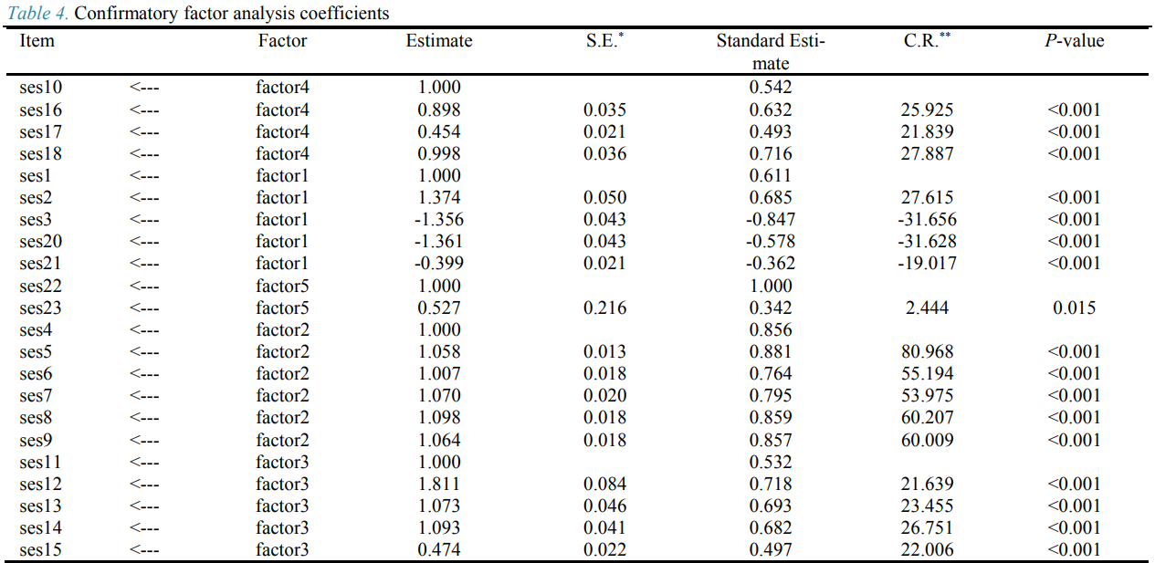
* Standard Error; ** Composite Reliability
18/24

Slide 19
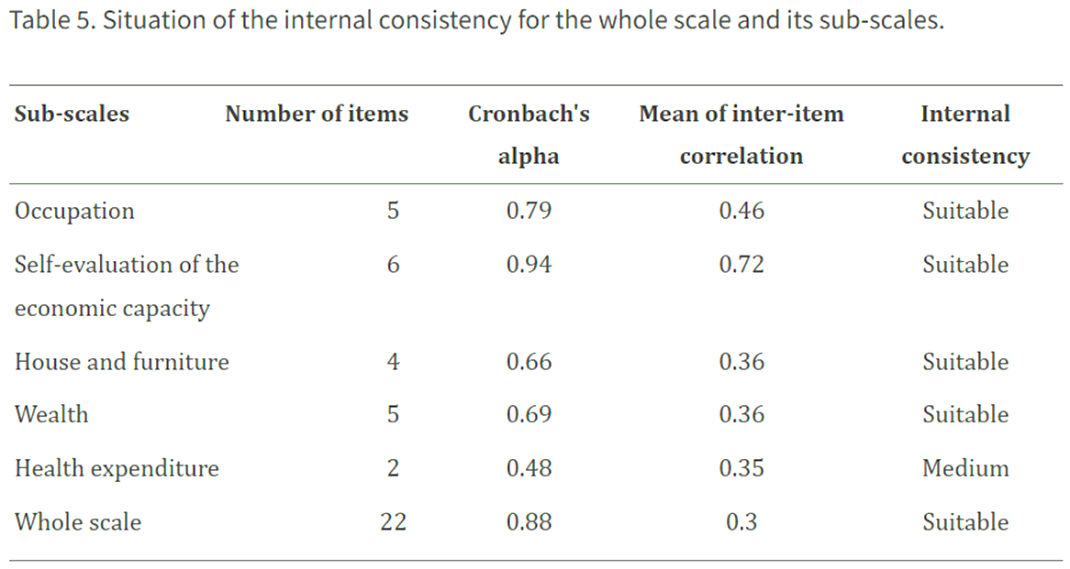
Results…
Internal Consistency:
19/24

Slide 20
Discussion
The exploratory factor analysis resulted in the extraction of 5 factors, confirmed by the confirmatory factor analysis.
Occupation:
Occupational prestige was determined based on the review of the previous studies in this regard and expert comments
Considered grade of service for military occupations
Considered and ranked the occupations that had not been assessed in the previous studies
Education level (number of years of successful education) and income status were loaded in this factor
20/24

Slide 21
Discussion …
self-evaluation of the economic capacity:
Ability to measure household expenses at all times
Have high internal consistency (0.96)
Wealth:
Possible completion bias is not observed in the extracted items regarding factors such as house
House and furniture:
Used the monetary value of home appliances
Health expenditure:
Health expenditure cannot be converted into properties
It has not been taken into account in the other studies conducted in Iran
21/24

Slide 22
Discussion …
Limitations:
The lack of responsibility
They could not assess the questionnaire's efficacy in rural areas
The inability to determine the occupational prestige of some jobs
22/24

Slide 23
Conclusion
All the validity and reliability indices were confirmed, and the Iranian version of the SES questionnaire maintained its validity in a larger population with broader geographical coverage. Therefore, this instrument is applicable in extensive studies with nationally divergent levels.
23/24

Slide 24
Related articles
Title: measurement components of socioeconomic status in health-related studies in Iran (Shafiei, 2019)
Results: according to the Delphi evaluation, 15 items were identified ≥ 3.5 for measuring SES of Iranian households: household size, head of household education, head of household job, household monthly income, type of school that children attend, house ownership, local value of residence, number of rooms in the house, house area, personal computer/laptop, smart cell phone, 3D TV, dishwasher, microwave, and car ownership.
Title: Constructing Pragmatic Socioeconomic Status Assessment Tools to Address Health Equality Challenges (Tajik & Majdzadeh, 2013)
Results: a minimum set of six variables including having kitchen, bathroom, vacuum cleaner, washing machine, freezer and personal computer could successfully discriminate SES of the population.

Slide 25
References
Goretzko, D., Siemund, K., & Sterner, P. (2023). Evaluating Model Fit of Measurement Models in Confirmatory Factor Analysis. Educational and Psychological Measurement, 84(1), 123-144. https://doi.org/10.1177/00131644231163813 (Original work published 2024)
Wichmann, F.A., Hill, N.J. The psychometric function: I. Fitting, sampling, and goodness of fit. Perception & Psychophysics 63, 1293–1313 (2001). https://doi.org/10.3758/BF03194544
Koo TK, Li MY. A Guideline of Selecting and Reporting Intraclass Correlation Coefficients for Reliability Research. J Chiropr Med. 2016 Jun;15(2):155-63. doi: 10.1016/j.jcm.2016.02.012. Epub 2016 Mar 31. Erratum in: J Chiropr Med. 2017 Dec;16(4):346. doi: 10.1016/j.jcm.2017.10.001. PMID: 27330520; PMCID: PMC4913118.
Hajian-Tilaki K. Receiver Operating Characteristic (ROC) Curve Analysis for Medical Diagnostic Test Evaluation. Caspian J Intern Med. 2013 Spring;4(2):627-35. PMID: 24009950; PMCID: PMC3755824.
Bland JM, Altman DG. Statistical methods for assessing agreement between two methods of clinical measurement. Lancet. 1986 Feb 8;1(8476):307-10. PMID: 2868172.
Brown, T. A. (2015). Confirmatory factor analysis for applied research (2nd ed.). The Guilford Press.
Willmer, M., Westerberg Jacobson, J., & Lindberg, M. (2019). Exploratory and confirmatory factor analysis of the 9-item Utrecht Work Engagement Scale in a multi-occupational female sample: A cross-sectional study. Frontiers in Psychology, 10, Article 2771. https://doi.org/10.3389/fpsyg.2019.02771
Tavakol M, Wetzel A. Factor Analysis: a means for theory and instrument development in support of construct validity. Int J Med Educ. 2020 Nov 6;11:245-247. doi: 10.5116/ijme.5f96.0f4a. PMID: 33170146; PMCID: PMC7883798.
Kaiser, H.F. An index of factorial simplicity. Psychometrika 39, 31–36 (1974). https://doi.org/10.1007/BF02291575
Shafiei, S., Yazdani, S., Jadidfard, MP. et al. Measurement components of socioeconomic status in health-related studies in Iran. BMC Res Notes 12, 70 (2019). https://doi.org/10.1186/s13104-019-4101-y
Tajik P, Majdzadeh R. Constructing pragmatic socioeconomic status assessment tools to address health equality challenges. Int J Prev Med. 2014 Jan;5(1):46-51. PMID: 24554991; PMCID: PMC3915472.
24/24

Slide 26
Thanks for your attention

