Slide 1



Does cycle commuting reduce the risk of mental ill-health?
An instrumental variable analysis using distance to nearest cycle path
Journal Club 2024
Laurie Berrie, Zhiqiang Feng, David Rice, Tom Clemens ,Lee Williamson and Chris Dibben
International Journal of Epidemiology
2024, 53(1), dyad153
Ebrahim Varjavand
varjavandoffical@gmail.com
25/05/2024

Slide 2
Outline
Introduction
Methods
Results
Discussion
Glance
Of 33

Slide 3
The effect of physical activity on mental health
Activity commuting
Cycle Commuting Benefits
Costs of mental ill-health
The difference between this study and previous studies
Introduction
Of 33

Slide 4
Outline
Introduction
Methods
Results
Discussion
Glance
Of 33

Slide 5
Data Source: 2011 Scottish Census linked with Scottish National Prescription Information System (PIS) records over 5 years.
PIS Includes all NHS Scotland community prescriptions.
Privacy & Security: Anonymized data analyzed in a secure environment by eDRIS, Public Health Scotland.
Results reviewed by National Records of Scotland and eDRIS to minimize personal data disclosure risk.
Methods
Data source
Of 33

Slide 6
Demographics: Residents of Glasgow City and City of Edinburgh, aged 16–74 years.
Employment Status: Individuals employed and commuting on census night.
Initial Population: 400,814 people in 2011.
Exclusions:
  Those with mental ill-health prescriptions before the census.
  Residents living >2 km from the nearest cycle path.
Final Sample: 338,253 individuals analyzed.
Methods
Study population
Of 33

Slide 7
Survey Question: “How do you usually travel to your main place of work or study?”
Responses Included:
Driving (car/van)
Passenger (car/van)
Walking
Bus/Minibus/Coach
Train
Underground/Subway/Metro/Tram
Taxi
Bicycle
Motorcycle/Scooter/Moped
Other
Responses categorized into a binary variable - Bicycle vs All Other Modes of commute.
Methods
Variables
Exposure
Of 33

Slide 8
Data Source: PIS data on new prescriptions post-census over 5 years.
Exclusions: Low-dose Amitriptyline & Nortriptyline (≤30 mg/day) used for non-mental health conditions.
Created a binary variable:
  0: No prescription for antidepressants/anxiolytics.
  1: At least one prescription for antidepressants/anxiolytics.
A single prescription indicates potential depression or anxiety due to conservative prescription practices in Scotland.
Methods
Variables
Outcome
Of 33

Slide 9
IV Used: Distance to nearest cycle path.
Straight-line distance from residential address to cycle path.
Proximity: Proven effective IV in previous studies.
The individual residential addresses are represented using grid references for the centroids of postcodes (average 30 households).
Data Sources: Edinburgh cycle paths (2010), Glasgow cycle paths (2014).
Tool Used: Feature Manipulation Engine.
Methods
Variables
Instrument
Of 33

Slide 10
Challenge : Directly estimating the impact of cycling to work on mental health can be biased by unobserved confounding. The actual Effects of cycling on mental health is mixed with the influence of these unobserved confounding.
Solution: To counteract this, use an IV approach, which isolates the true effect of cycling.
IV analyses mimic randomized–controlled experiments in which the instrument effectively randomizes individuals to the exposure.
Assumptions:
  Relevance
  Exchangeability
  Exclusion Restriction
Methods
Instrumental variable assumptions
Of 33

Slide 11
Instrument must be associated with the exposure.
There is evidence for this relationship.
Empirically test this assumption: Calculation of F-statistic to measure the relationship strength between distance to cycle path and cycling.
Methods
Instrumental variable assumptions
Relevance
Of 33

Slide 12
No common causes are shared between the instrument and the outcome.
In This Study there are no common causes between distance to cycle path and prescriptions for antidepressants or anxiolytics.
Literature Review: No common causes found.
Therefore, statistically adjust of the analysis for other covariates not performed
Due to systematic differences in cycling and prescription of antidepressants and anxiolytics between men and women, additional analysis were conducted separated by sex.
Methods
Instrumental variable assumptions
Exchangeability
Of 33

Slide 13
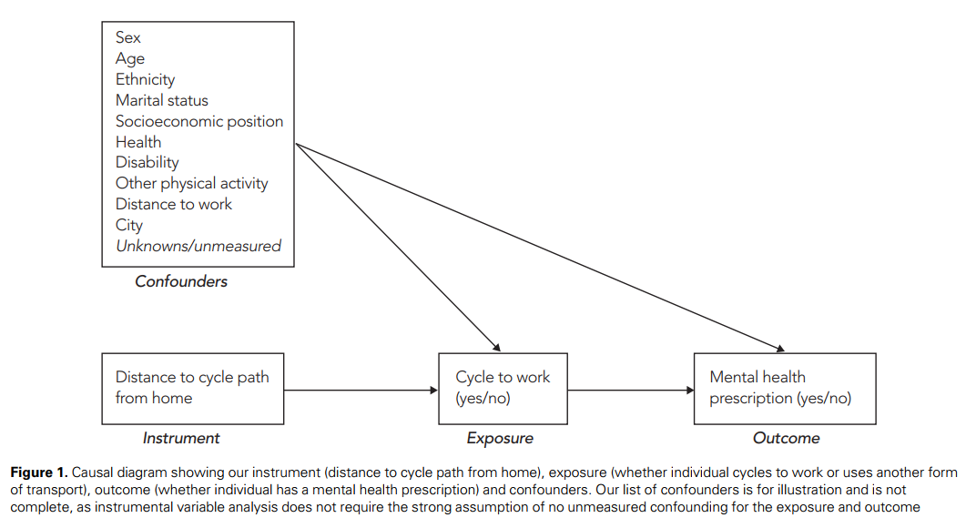
Of 33

Slide 14
No direct link between the instrument and the outcome, except through exposure.
In this study, distance to cycle path shouldn’t directly influence prescriptions for antidepressants or anxiolytics.
Given the development of the cycle path network and multiple residential decisions, it is unlikely that proximity to cycle paths directly affects the prescription of antidepressants or antianxiety medications, except by influencing cycling to work.
Methods
Instrumental variable assumptions
Exclusion restriction
Of 33

Slide 15
A continuous instrument and binary exposure and outcome variables
Bivariate probit (biprobit) model for IV analysis.
The biprobit model uses simultaneous likelihood estimation to estimate the average treatment effect.
Software Used: All analyses in R, biprobit modeling in Stata.
CIs 95% : calculated with Delta Method via Stata’s ‘margins’ command.
Methods
Analyses
Of 33

Slide 16
Separate modeling for antidepressants and anxiolytics.
Remove those who walk to work from the data set.
Use a negative control outcome (NCO) to evaluate whether the IV assumptions hold.
Carry out a ‘standard’ adjusted analysis using logistic regression to model the main outcome and exposure
Methods
Sensitivity analyses
Of 33

Slide 17
Outline
Introduction
Methods
Results
Discussion
Glance
Of 33

Slide 18
Commutes <5 km: 54.4% in Edinburgh, 51.8% in Glasgow (2011 Census).
Cycling to Work: 1.85% in Glasgow, 4.8% in Edinburgh; higher among men.
Study Population: 338,253 individuals (190,227 males, 188,026 females).
Prescriptions:
  Overall: 9.1% of males, 15.6% of females had prescriptions for anxiolytics or antidepressants.
  Cyclists: 7.5% of males, 10.2% of females had prescriptions.
  Non-Cyclists: 9.2% of males, 15.7% of females had prescriptions.
Results
Population characteristics
Of 33

Slide 19
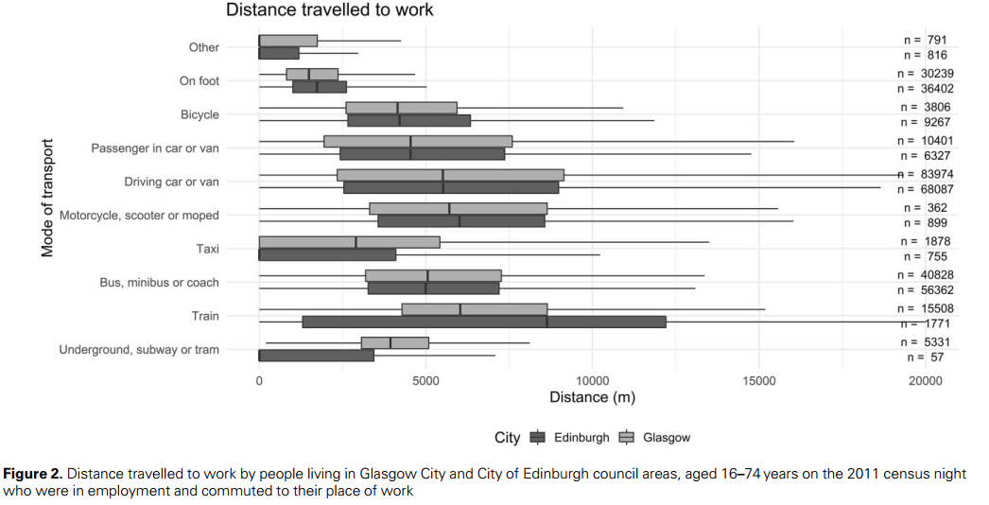
Of 33

Slide 20
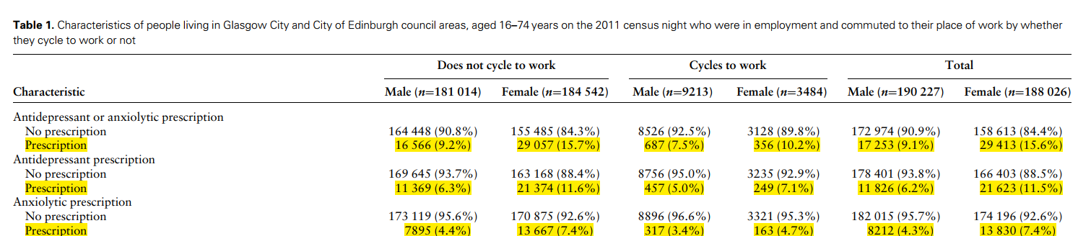
Of 33

Slide 21
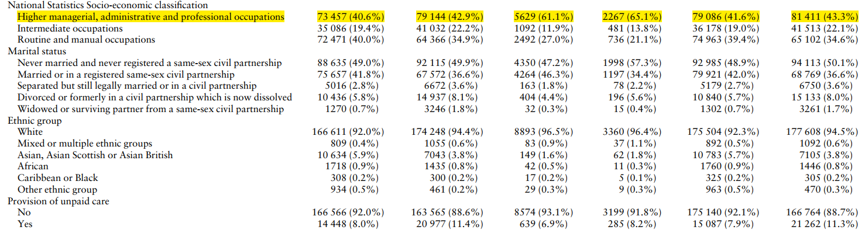
Of 33

Slide 22
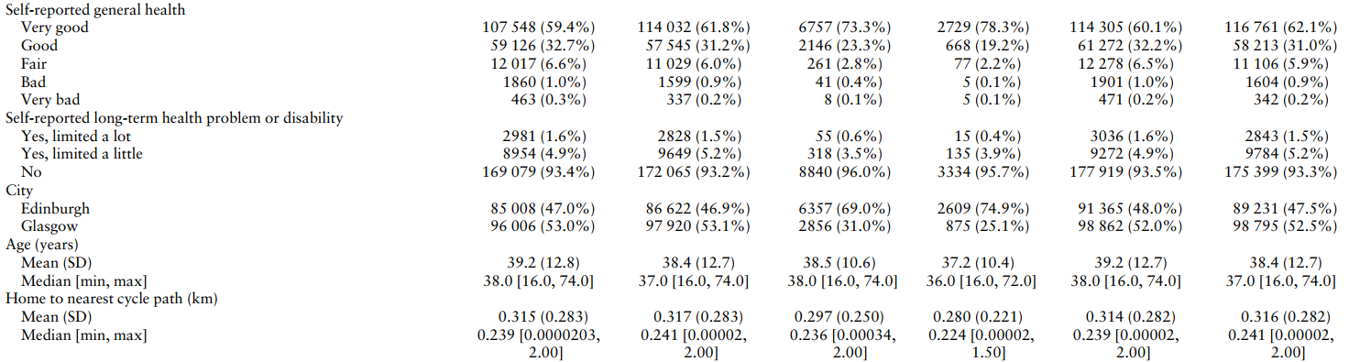
Of 33

Slide 23
The F-statistic, calculated from the logistic regression model, is 143.
There is no ‘rule of thumb’ for the size of the F-statistic in the case in which the model is non-linear or with such a large sample size.
Literature Recommendation: Cut-off value of 16.38.
The instrument is not weak
Results
Instrument strength
Of 33

Slide 24
Estimates the average treatment effect
Difference in the mean average probability of the outcome occurring between those who cycle to work and those who do not.
–15.1% (95% CI: –15.3% to –15.0%) mean average reduction.
Smaller effect in males and those with anxiolytic prescriptions compared to females and those with antidepressant prescriptions.
Results
Biprobit model
Of 33

Slide 25
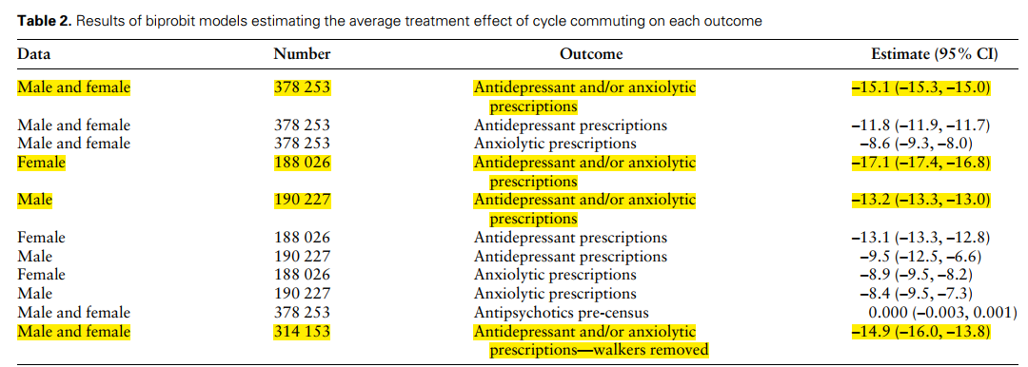
Of 33

Slide 26
The biprobit model, excluding walkers from the dataset, estimates a mean reduction of -14.9% (95% CI: -16.0% to -13.8%) in the probability of receiving antidepressant/anxiolytic prescriptions over 5 years among cycle commuters compared to non-active mode commuters.
Results
Results of sensitivity analyses
Of 33

Slide 27
By focusing on antipsychotic medication post-2011 census, analysis revealed an average treatment effect of -0.000% (95% CI: -0.003% to 0.001%), indicating no correlation between residential proximity to cycle paths and potential confounders.
Results
Negative control outcome analysis
Of 33

Slide 28
Outcome: Prescriptions for antidepressants and/or anxiolytics.
Control Variables: Age, sex, ethnicity, marital status, socio-economic classification, city, health status, disability, and caregiving status.
Estimated Effect: -13.4% reduction in relative odds of having a prescription for cycle commuters (CI: -18.9% to -7.7%).
Comparison with Biprobit Models: Not directly comparable, but consistent in direction and significance.
Results
Logistic regression analysis
Of 33

Slide 29
Outline
Introduction
Methods
Results
Discussion
Glance
Of 33

Slide 30
The findings of this study
The advantages of this study
Challenges of this study
Limitations of this study
Recommendations of this study
Discussion
Of 33

Slide 31
Outline
Introduction
Methods
Results
Discussion
Glance
Of 33

Slide 32
Using a quasi-experimental approach to investigate whether cycling to work can reduce mental health risks
Using distance to cycling path as an instrumental variable (IV) for the first time.
Instrumental variable assumptions
  Relevance
  Exchangeability
  Exclusion restriction
Instrumental variable analysis using probit model
Conducting a series of sensitivity analyses
  Use of a negative control outcome
Glance
Of 33

Slide 33
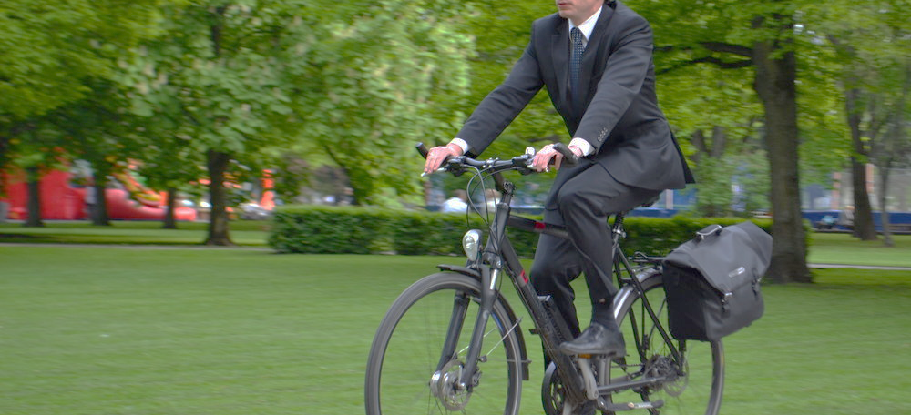
Thanks for your attention
Of 33
Ebrahim Varjavand

