Slide 1
The latest epidemiological update of HIV/AIDS
Presenter: Zeynab Darini
email: darini.zeynab@yahoo.com
1/35

Slide 2
OUTLINE
The latest update of the disease
Introduction
Epidemiology of HIV/AIDS in the world
Epidemiology of HIV/AIDS in the IRAN
The incidence and mortality of HIV/AIDS in the last 33 years
2/35

Slide 3
Introduction
1- Acute infection: a flu-like infection, after the HIV virus enters the body
2- Asymptomatic positive (PLHIV): A person without symptoms and signs with a positive lab-test
3- Swelling of lymph nodes: The possibility of contract various diseases, especially opportunistic infections with a decrease in immune cells
4- Apparent immune weakness: CD4 less than 200 per 1ml of blood and reduced chance of survival, without treatment
Stages of the disease
3/35

Slide 4
Introduction…
1- Low level: Viral infection in general population less than 1% and in high-risk groups less than 5%
2- Concentrated level: Viral infection in general population is less than 1% and in some high-risk groups more than 5%
3- Generalized level: Viral infection more than 1% in the general population
levels of spread disease in the epidemiological point of view
4/35

Slide 5
Introduction…
1- Female sex workers (FSWs)
2- Men who have sex with men (MSM)
3- Injection drug user (IDU)
high-risk groups: long-distance drivers, men in uniform, sailors and fishermen, street children and girls, prisoners, migrants, displaced populations.
High risk groups and key population
5/35

Slide 6
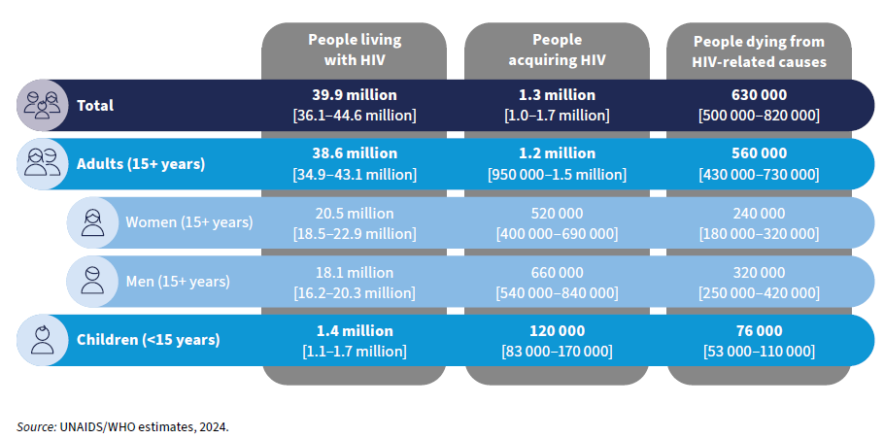
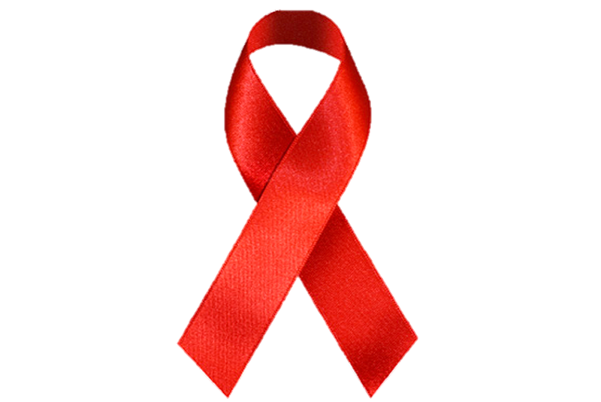
Epidemiology of HIV/AIDS in the world
6/35

Slide 7
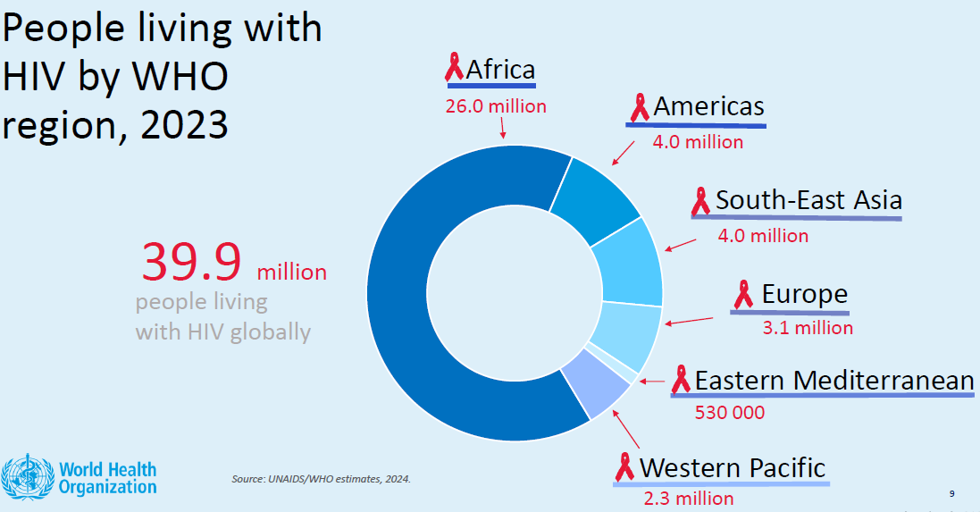
Epidemiology of HIV/AIDS in the world
7/35

Slide 8
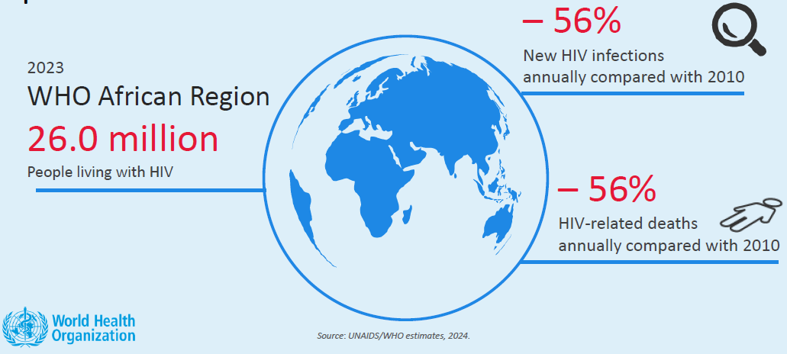
Summary of regional HIV epidemic
8/35

Slide 9
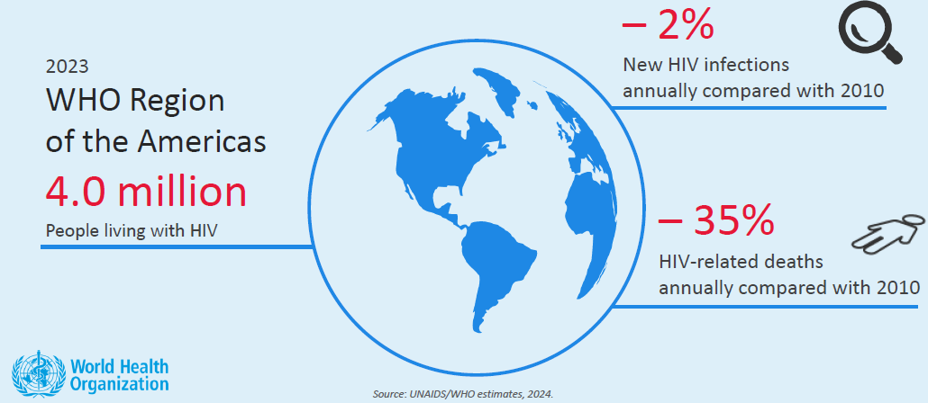
Summary of regional HIV epidemic
9/35

Slide 10
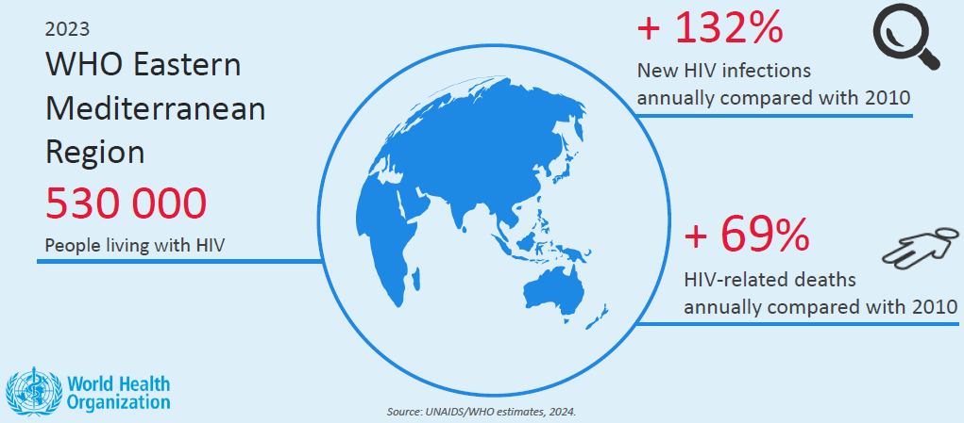
Summary of regional HIV epidemic
10/35

Slide 11
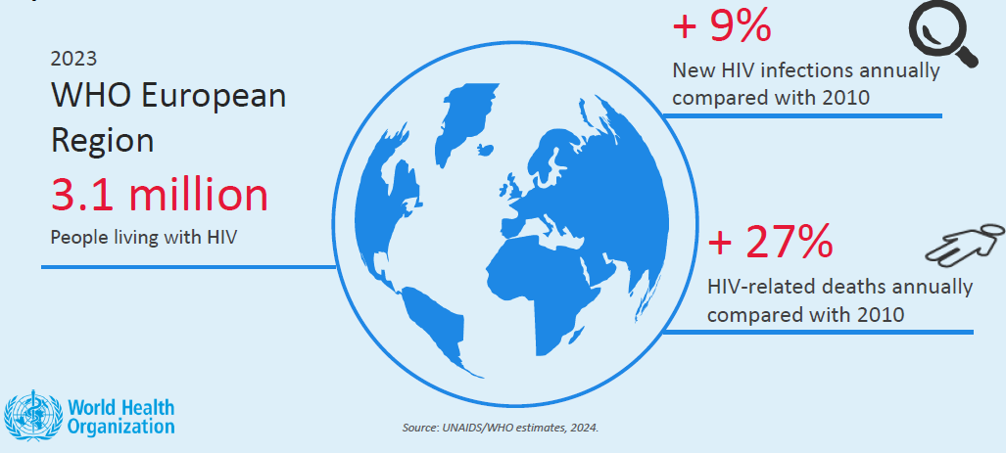
Summary of regional HIV epidemic
11/35

Slide 12
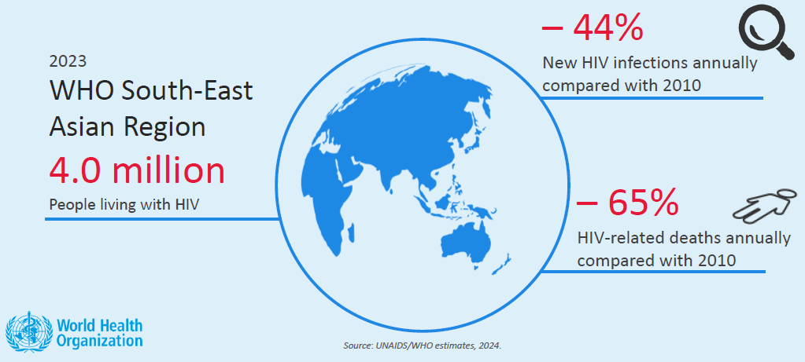
Summary of regional HIV epidemic
12/35

Slide 13
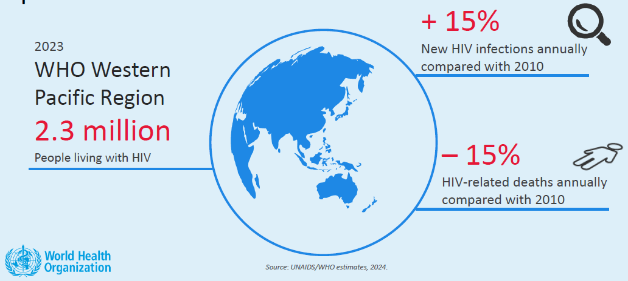
Summary of regional HIV epidemic
13/35

Slide 14
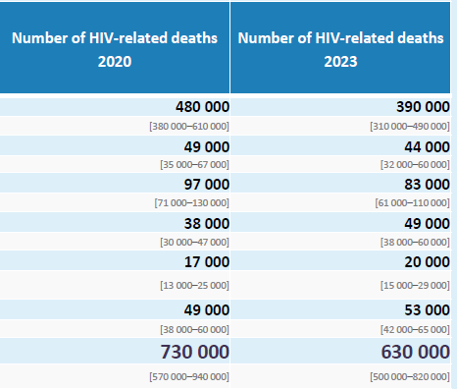
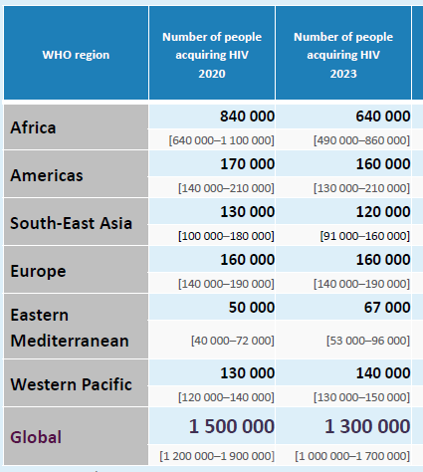
New HIV infections by WHO region, 2020−2023
14/35

Slide 15
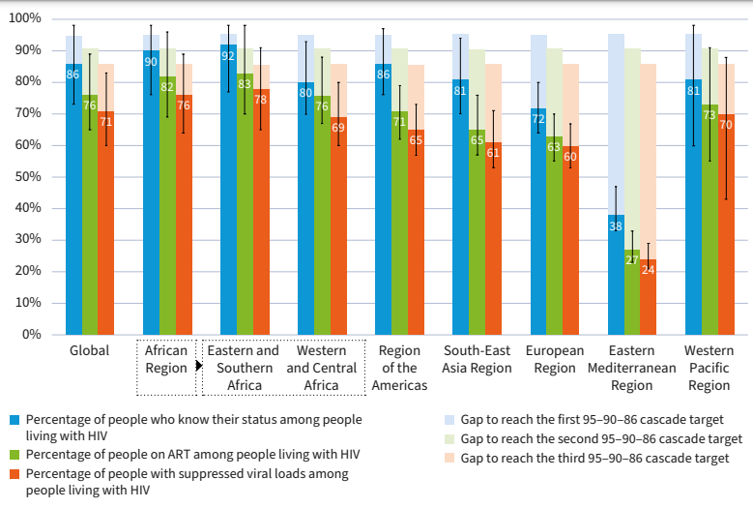
Progress towards achieving the HIV testing, treatment and viral load suppression cascades targets among people living with HIV, globally and by WHO region, 2023
15/35

Slide 16
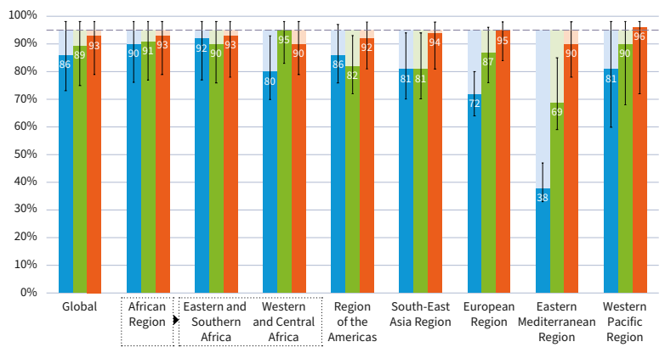
Progress towards 95-95-95 targets, by WHO region, 2023
16/35

Slide 17
HIV/AIDS Estimates in IRAN (2023)
Adults and children living with HIV | 43 000 [30 000 – 77 000]
Adults aged 15 and over living with HIV | 42 000 [30 000 – 76 000]
Women aged 15 and over living with HIV | 15 000 [9900 - 27 000]
Men aged 15 and over living with HIV | 28 000 [20 000 - 49 000]
Children aged 0 to 14 living with HIV | <1000 [<500 - 1800]
Adult aged 15 to 49 HIV prevalence rate | <0.1 [<0.1 - 0.1]
Women aged 15 to 49 HIV prevalence rate | <0.1 [<0.1 - <0.1]
Men aged 15 to 49 HIV prevalence rate | <0.1 [<0.1 - 0.2]
17/35

Slide 18
HIV/AIDS Estimates in IRAN (2023)…
Adults and children newly infected with HIV | 2600 [1300 - 6500]
Adults aged 15 and over newly infected with HIV | 2500 [1300 - 6200]
Women aged 15 and over newly infected with HIV | 1000 [<1000 - 2500]
Men aged 15 and over newly infected with HIV | 1500 [<1000 - 3600]
Children aged 0 to 14 newly infected with HIV | <200 [<100 - <500]
HIV incidence per 1000 population(adults 15-49) | 0.05 [0.03 - 0.12]
HIV incidence per 1000 population (all ages) | 0.03 [0.02 - 0.07]
18/35

Slide 19
HIV/AIDS Estimates in IRAN (2023)…
Adult and child deaths due to AIDS | 2000 [1100 - 4100]
Deaths due to AIDS among adults aged 15 and over | 1900 [1100 - 3900]
Deaths due to AIDS among women aged 15 and over | <1000 [<500 - 1400]
Deaths due to AIDS among men aged 15 and over | 1400 [<1000 - 2600]
Deaths due to AIDS among children aged 0 to 14 | <100 [<100 - <500]
Percent change in new HIV infections since 2010 | -22
Percent change in AIDS-related deaths since 2010 | -32
19/35

Slide 20
Age disaggregation of identified cases (1398-1401)
20/35

Slide 21
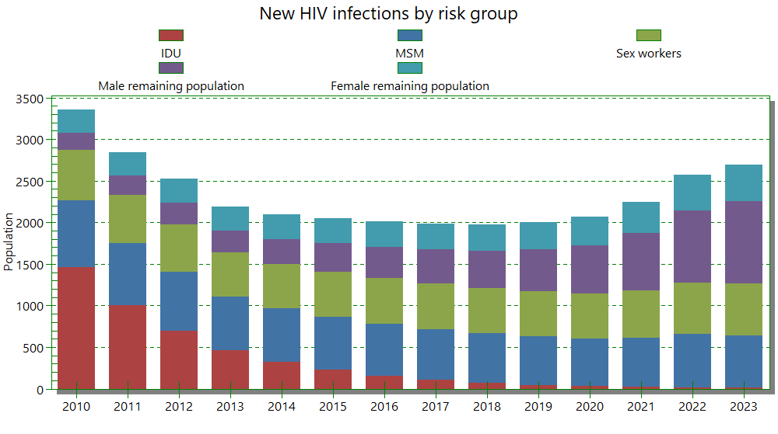
21/35

Slide 22
Rout of transmission in identified cases
22/35

Slide 23
Care and Treatment Cascade in IRAN (2023)
23/35

Slide 24
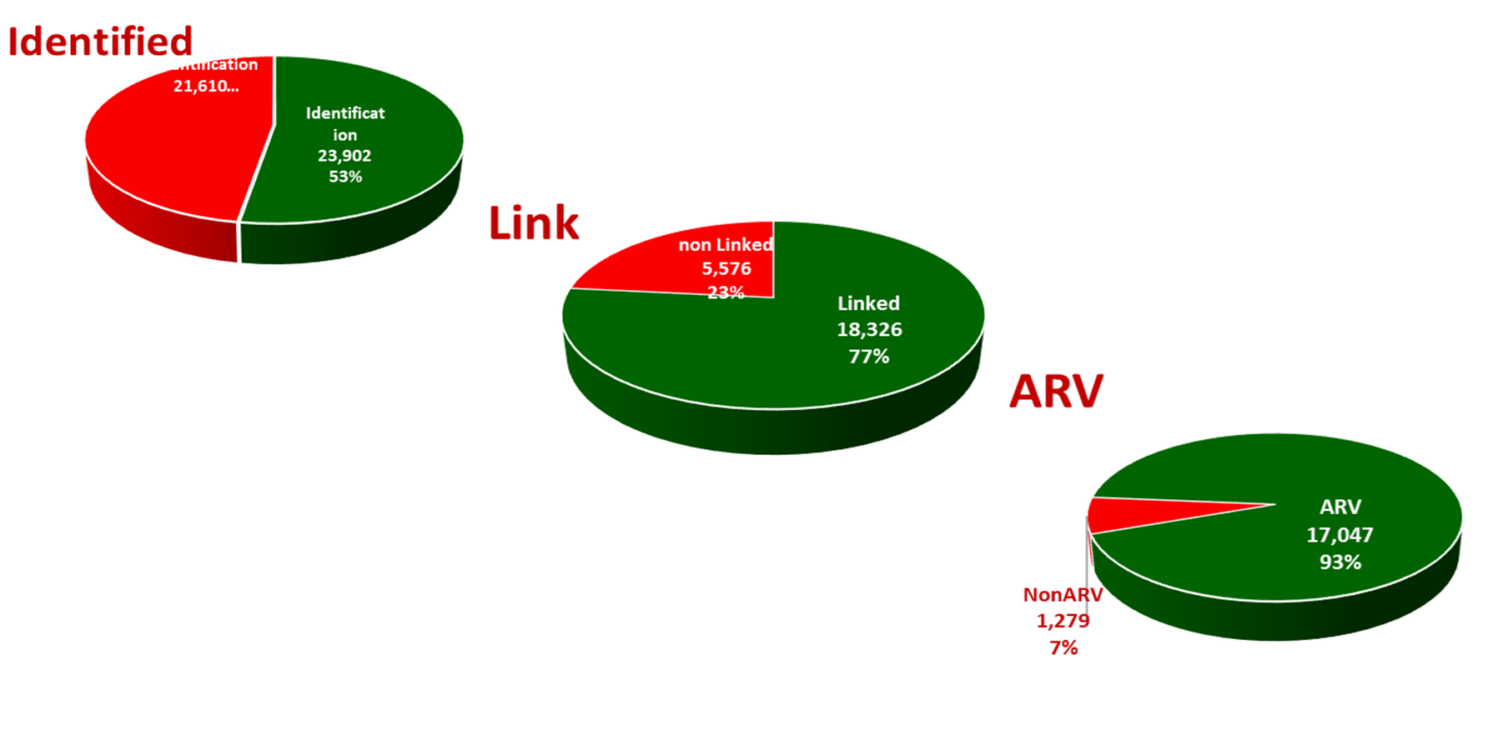
Care and Treatment Cascade in IRAN (2023)
24/35

Slide 25
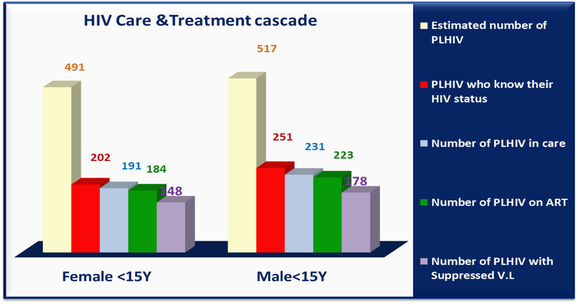
Care and Treatment Cascade in IRAN (2023)
25/35

Slide 26
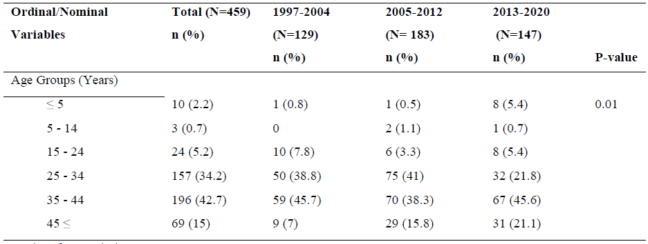
Epidemiological Characteristics of newly diagnosed cases
26/35

Slide 27
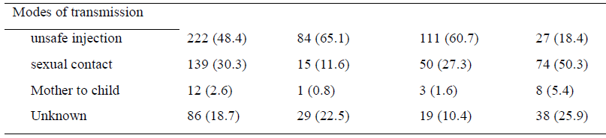
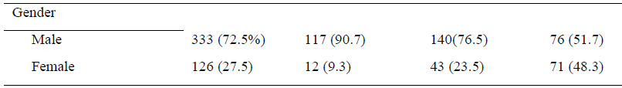
Epidemiological Characteristics of newly diagnosed cases…
27/35

Slide 28
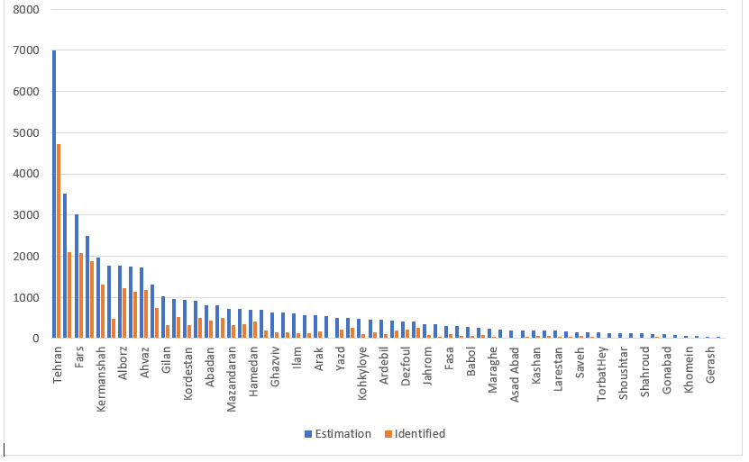
Sub-national Estimation
26/35

Slide 29
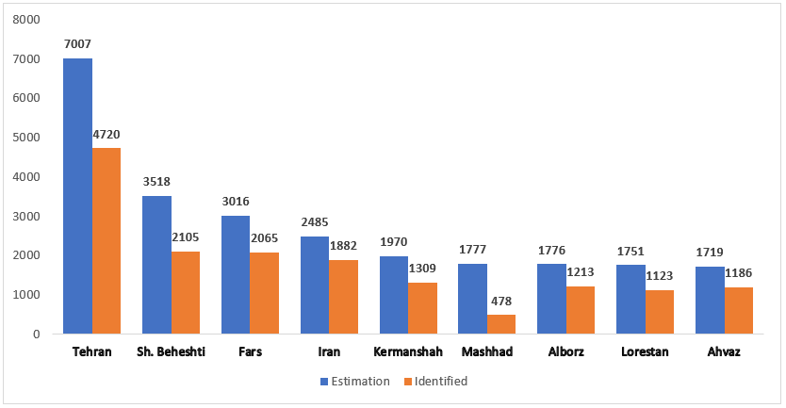
Sub-national Estimation
27/35

Slide 30
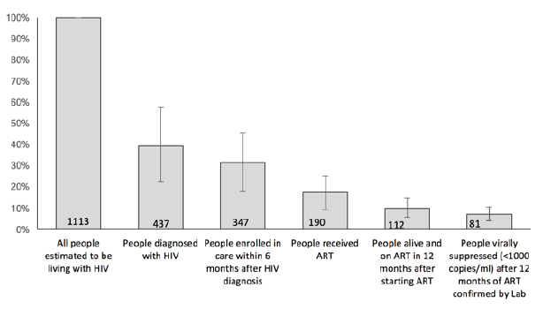
Care and Treatment Cascade in Kerman
28/35

Slide 31
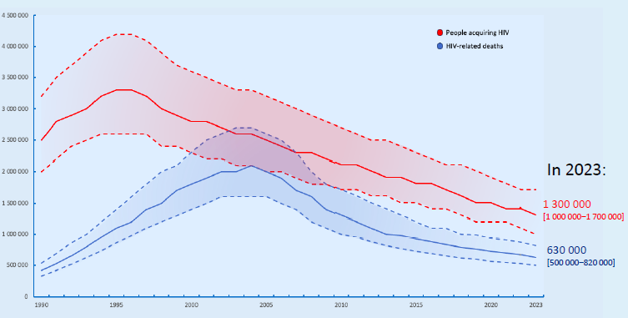
Number of people acquiring HIV and HIV related deaths, globally over time
29/35

Slide 32
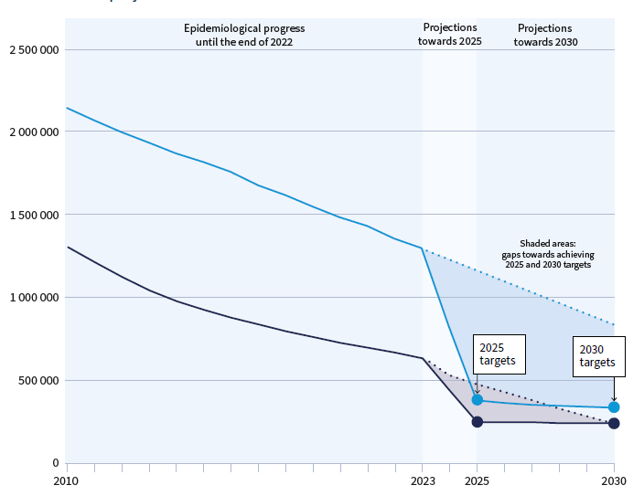
Global trends in people acquiring HIV and people dying from HIV-related causes, 2010–2023 and projections to 2030
30/35

Slide 33
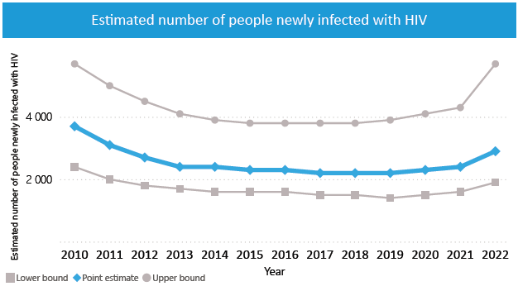
31/35

Slide 34
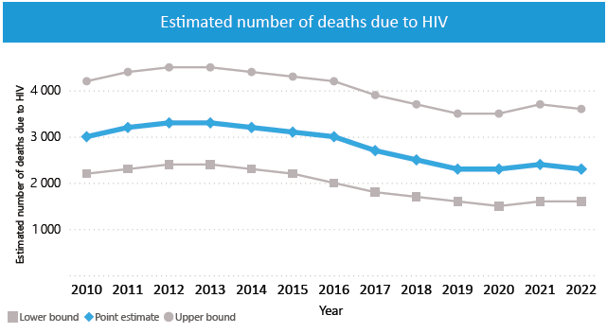
32/35

Slide 35
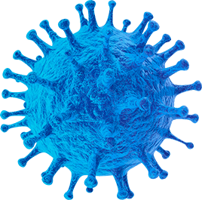
The impact of COVID-19 on HIV/AIDS
In a retrospective cohort study conducted in four continents, the number of HIV tests performed was reduced by 35.4% in 2020 as compared with that in 2019.
In hospital-based studies, the new patient encounters decreased by 23.5%-35.0% during the lockdown in the USA and the Netherlands.
ART initiation was shown to decrease from a median of 571 per week before lockdown to 375 per week after lockdown in 65 South African primary care clinic
33/35

Slide 36
reference
1- www.unaids.org
2- https://www.who.int/teams/global-hiv-hepatitis-and-stis programmes/hiv/strategic-information/hiv-data-and-statistics
3-https://www.unaids.org/en/regionscountries/countries/islamicrepublicofiran
4- MIRZAZADEH A, HOOSHYAR SH, RANJBAR E, SHARIFI H, SHAFIEI M, TAYERI K, HAGHDOOST A, RUTHERFORD GW. Evaluating the HIV continuum of care and treatment in a low prevalence city in Iran:: Kerman HIV-Friendly City initiative. eajahme. 2018 Feb 1;2(2).
5- Rick F., Odoke W., van den Hombergh J., Benzaken A.S., Avelino-Silva V.I. Impact of coronavirus disease (COVID-19) on HIV testing and care provision across four continents. HIV Med. 2022;23(2):169–177.
6-Jaafari Z, Mirzaei H, Moradi Y, Nasiri N, Mehmandoost S, Khezri M, Tavakoli F, Abbaszadeh S, Sharifi H. The impact of the COVID-19 pandemic on the provision of HIV/AIDS-related services in Iran: a qualitative study. BMC Health Services Research. 2023 May 3;23(1):430.
34/35

Slide 37
Thanks for your attention
35/35

